Slide 1
Terrestrial CO₂ fluxes, concentrations, and budgets
in USA and Northeast China
Xiao-Ming Hu¹, and Xiaolan Li²
http://www.caps.ou.edu/~xhu/
2019-06-27 @ Peking Univ.
¹Center for Analysis and Prediction of Storms, and School of Meteorology, University of Oklahoma
²Institute of Atmospheric Environment, China Meteorological Administration, Shenyang

Slide 2
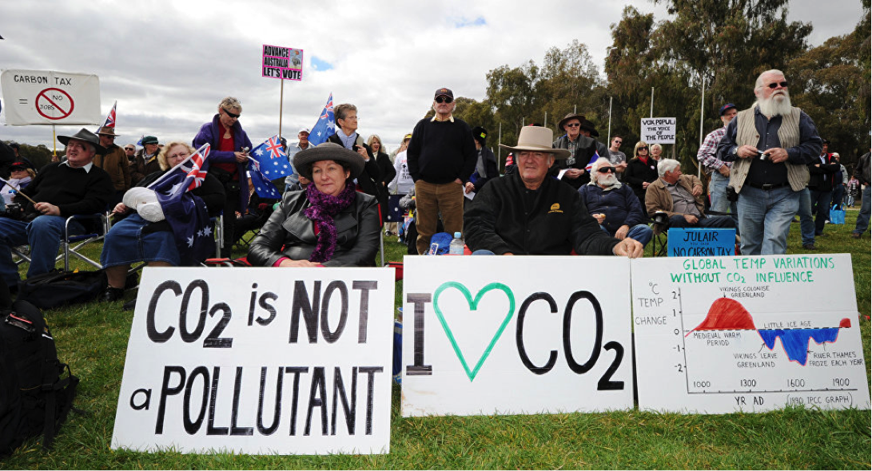
CO₂-induced global warming?

Slide 3
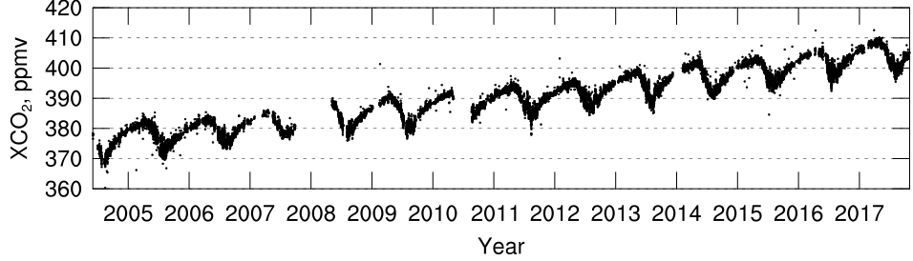
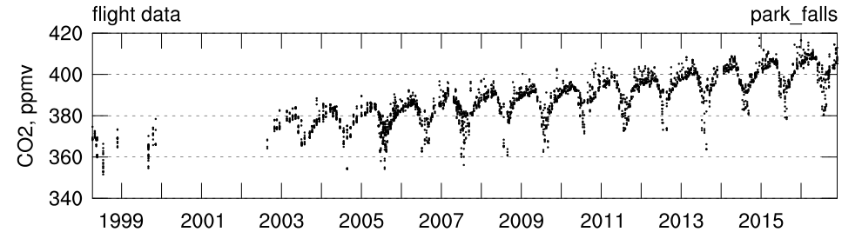
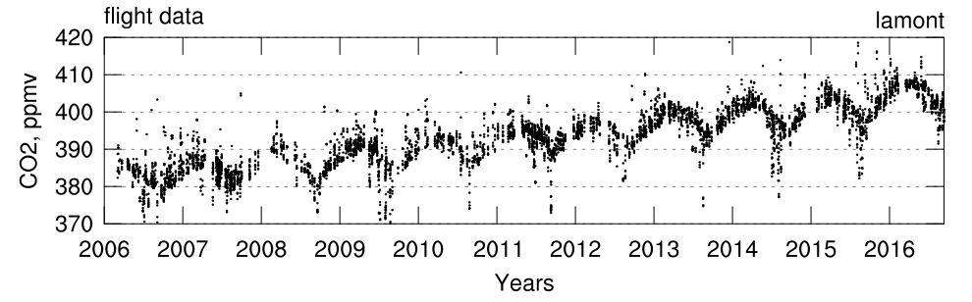
Trend of CO₂
Remote sensing
Park Falls, TCCON
In situ
In situ
Global warming controversial? Look at CO₂ trend!!

Slide 4
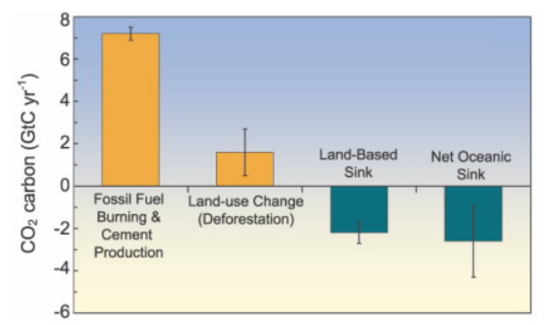
Global CO₂ sources and sinks
Terrestrial CO₂ fluxes
IPCC (2007)
Uncertainties of terrestrial CO₂ fluxes are large

Slide 5
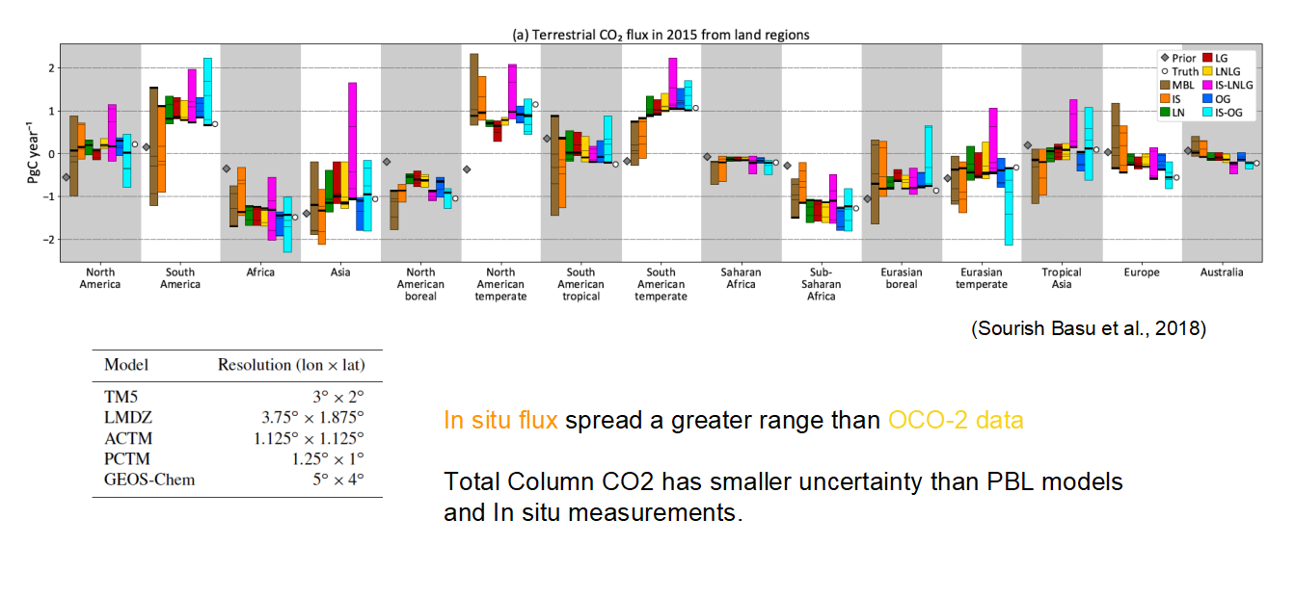
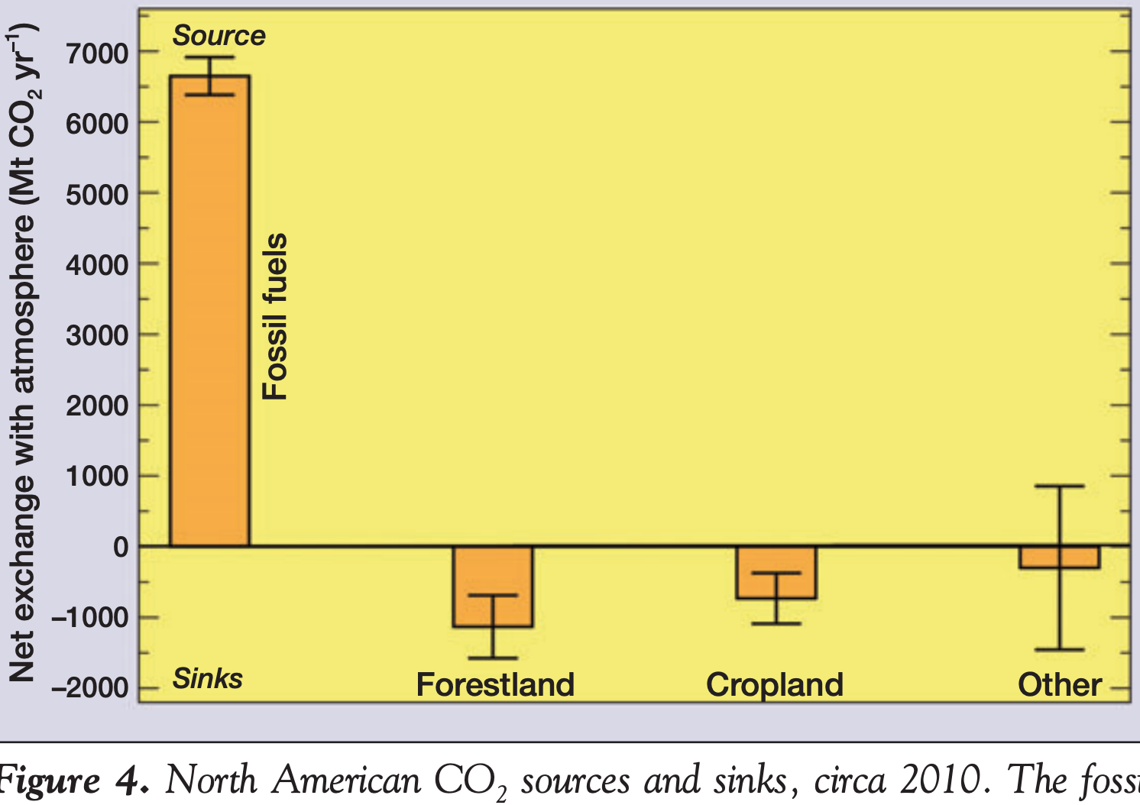
Terrestrial CO₂ fluxes in different regions
Uncertainties in each region/plant function are large too
King et al., 2012

Slide 6
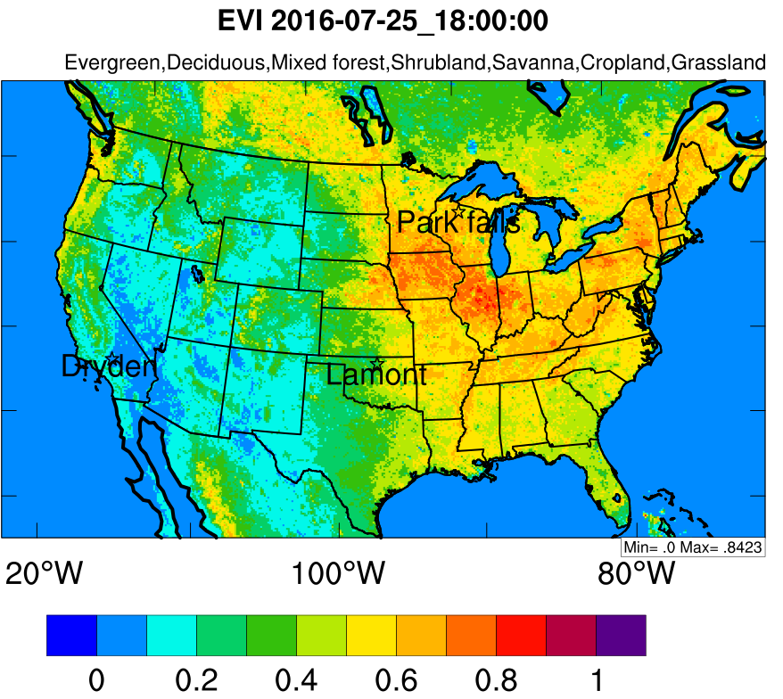
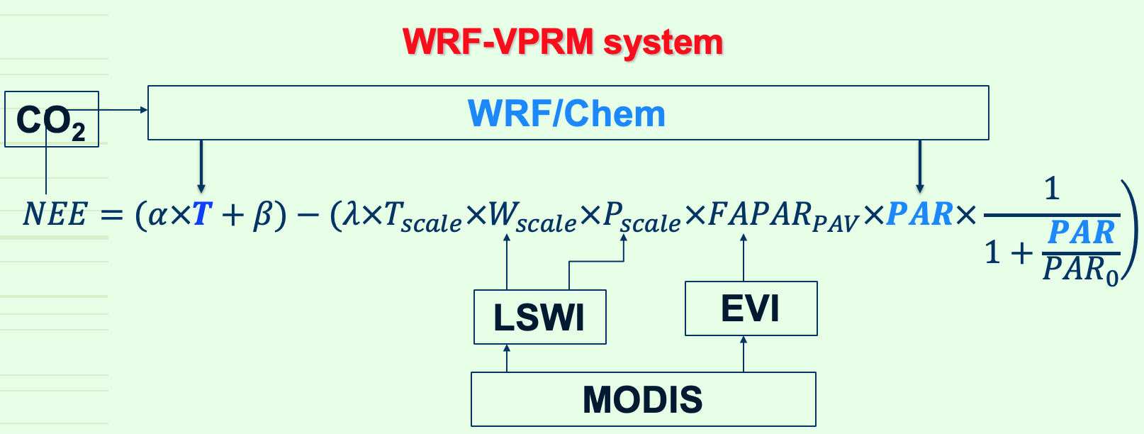
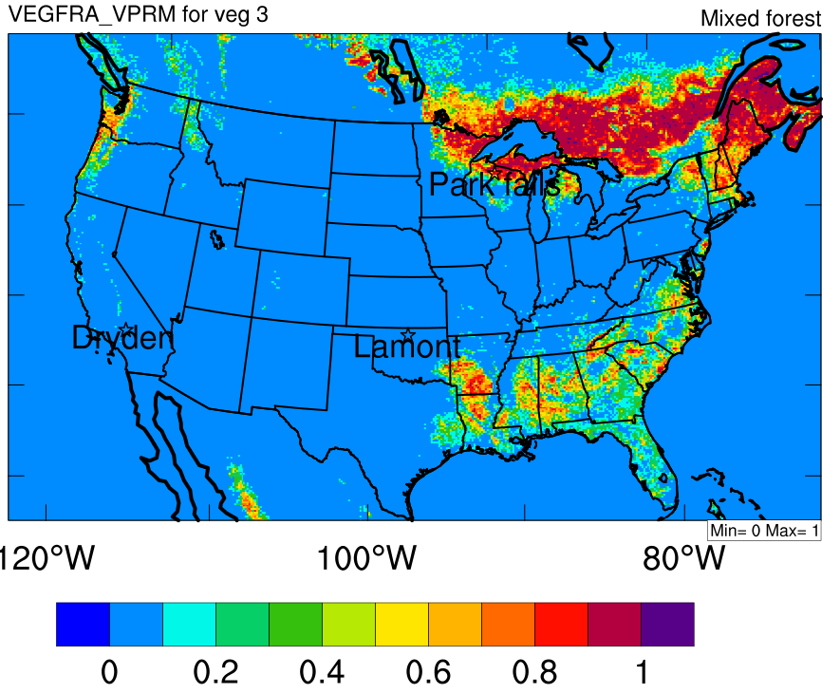
WRF/Chem-VPRM for CO₂ simulation
Vegetation Photosynthesis and Respiration Model (VPRM) (Xiao et al., 2004; Mahadevan et al., 2008; Ahmadov et al., 2007)

Slide 7
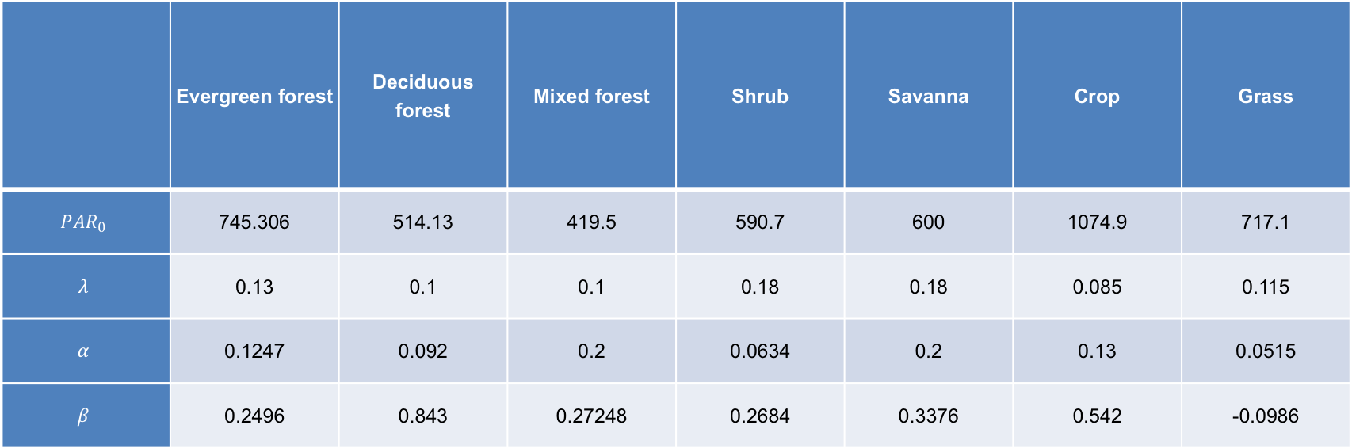
Implemented parameters from Hilton, Davis et al. (2013)
Calibrated using eddy covariance tower data over North America
 | Evergreen forest | Deciduous forest | Mixed forest | Shrub | Savanna | Crop | Grass
$${PAR}_{0}$$ | 745.306 | 514.13 | 419.5 | 590.7 | 600 | 1074.9 | 717.1
$$λ$$ | 0.13 | 0.1 | 0.1 | 0.18 | 0.18 | 0.085 | 0.115
$$α$$ | 0.1247 | 0.092 | 0.2 | 0.0634 | 0.2 | 0.13 | 0.0515
$$β$$ | 0.2496 | 0.843 | 0.27248 | 0.2684 | 0.3376 | 0.542 | -0.0986
And other minor changes to VPRM in WRF

Slide 8
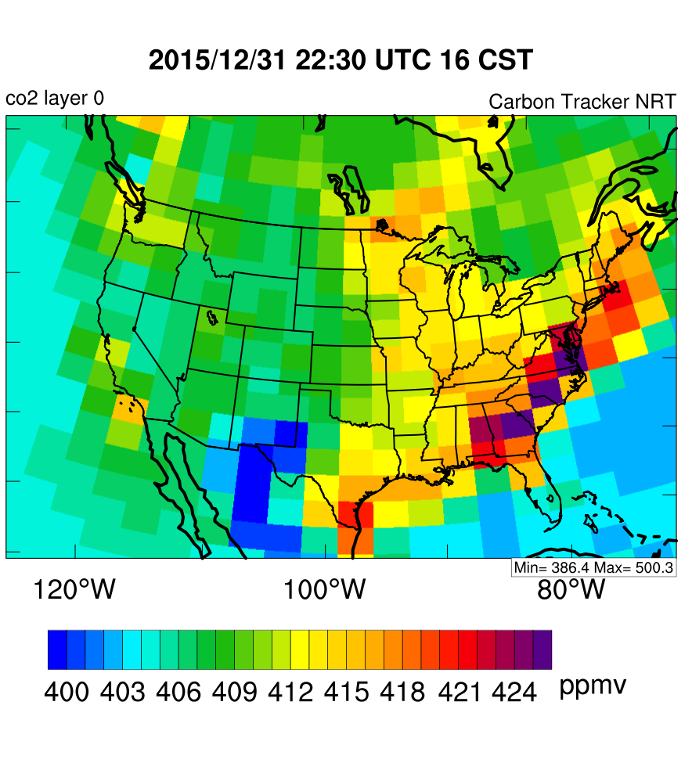
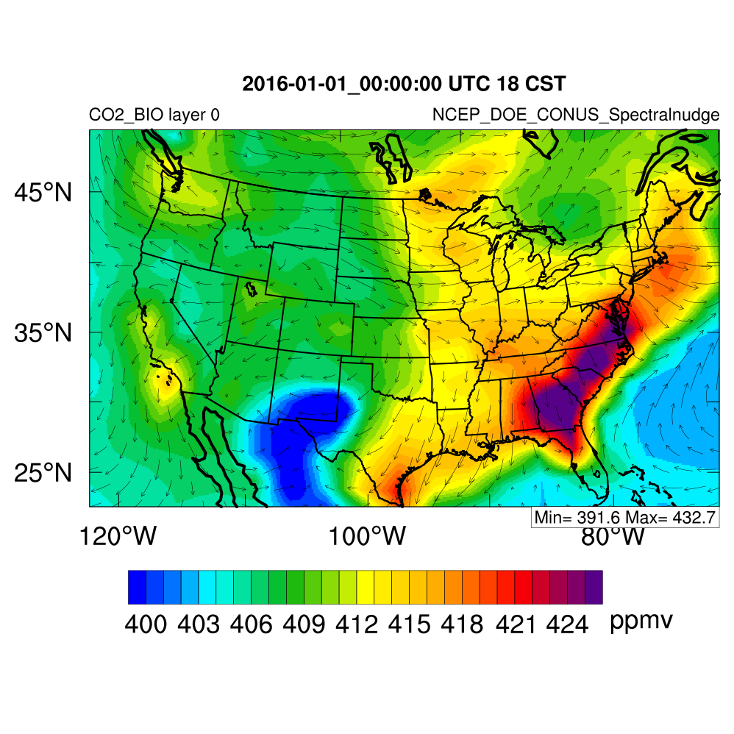
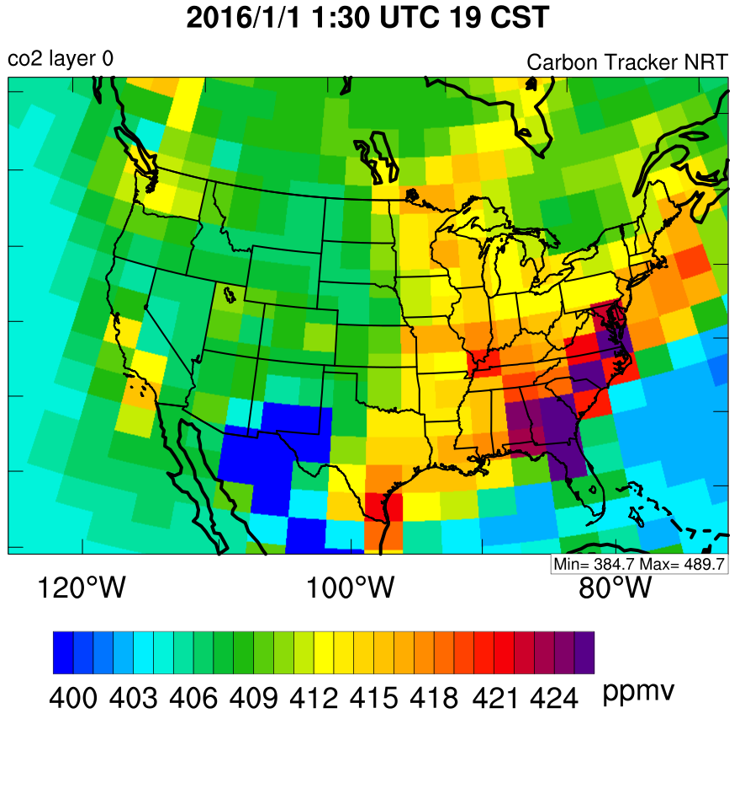
Downscaling in year 2016 from CT-NRT.v2017
WRF-VPRM IC
Point 1: both IC/BC are time dependent
Point 2: resolution of WRF-VPRM is much higher, adequate to investigate impact of weather

Slide 9
configuration for WRF-VPRM downscaling
Short wave radiation | Dudhia
Long wave radiation | rapid radiative transfer model (RRTM)
Boundary layer | YSU
Microphysics | Morrison
Cumulus | Grell-Freitas
Land surface model | NOAH
Vertical levels | 47
Horizontal resolution | 12 km × 12 km with 266×443 grid points
Time step | 60 seconds
Meteo initial and lateral boundary conditions | NCEP/DOE Reanalysis 2 (R2)
CO₂ initial and lateral boundary conditions | CarbonTracker global simulation 3º×2º outputs
Interior nudging | Spectral nudging
nudging variables | horizontal wind components, temperature, geopotential
nudging coefficient | 3×10⁻⁵ s⁻¹
nudging height | above PBL
wave number | 5 and 3 in the zonal and meridional directions respectively
nudging period | throughout the downscaling simulation

Slide 10
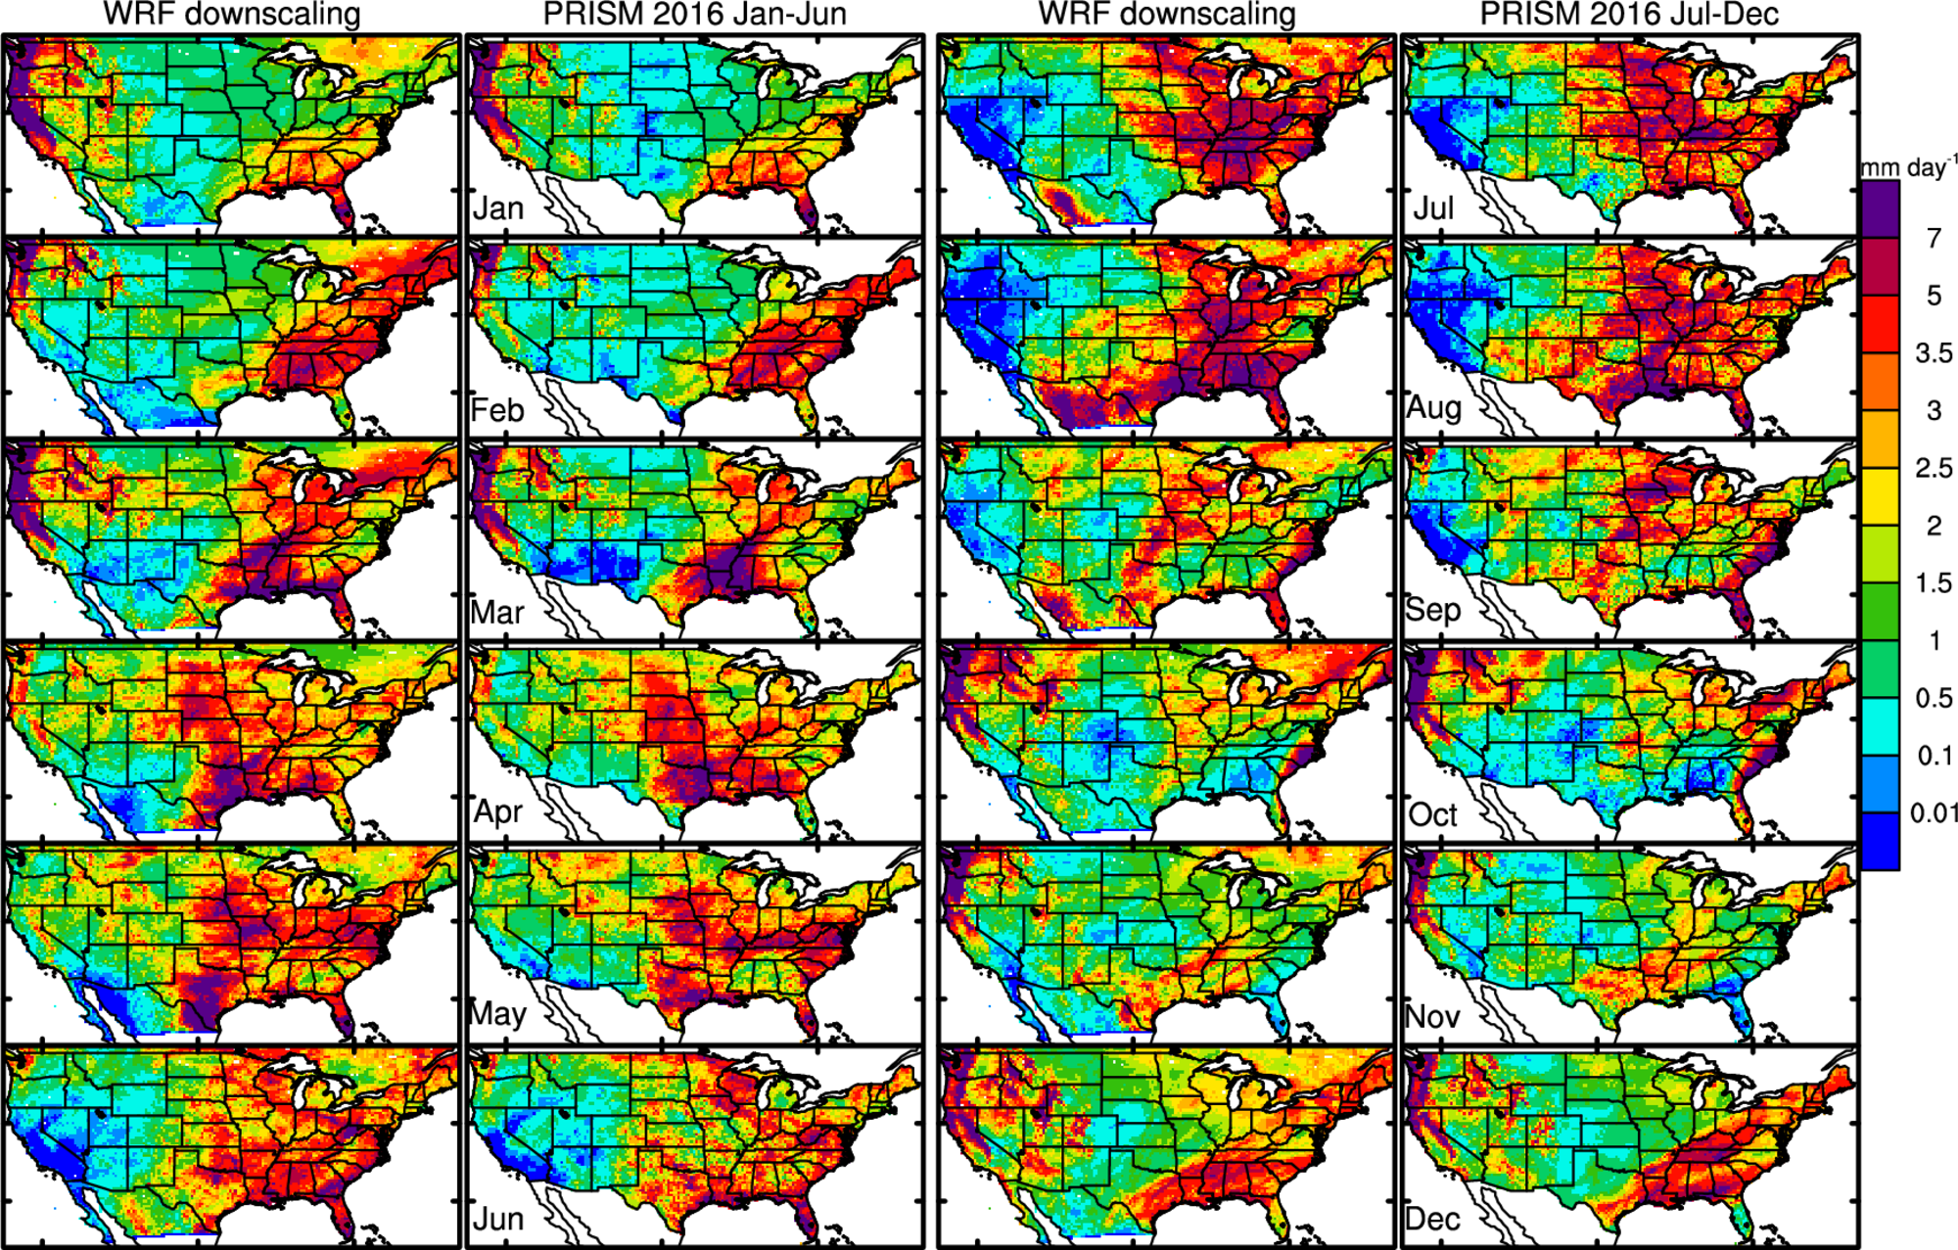
Downscaling captures the monthly variation of precipitation

Slide 11
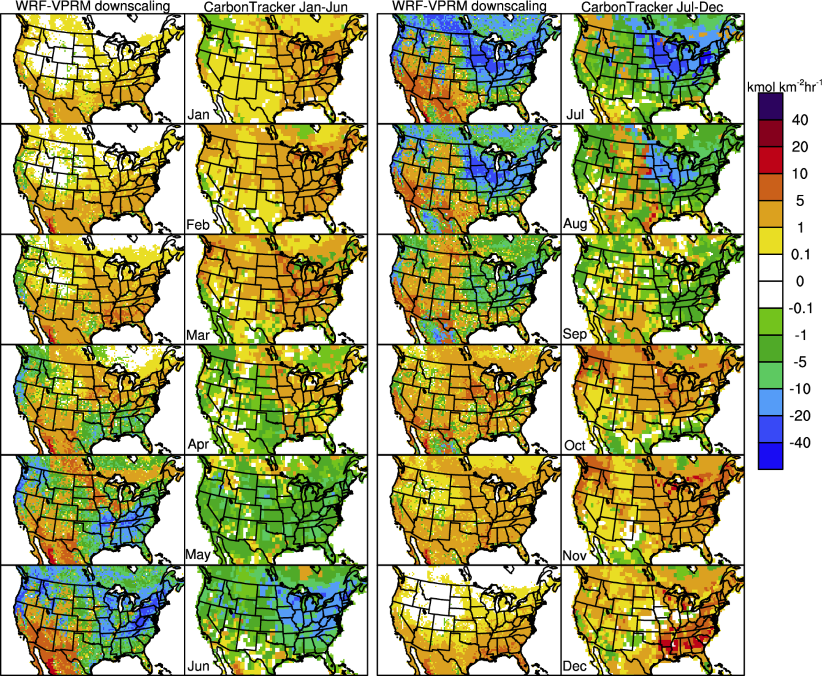
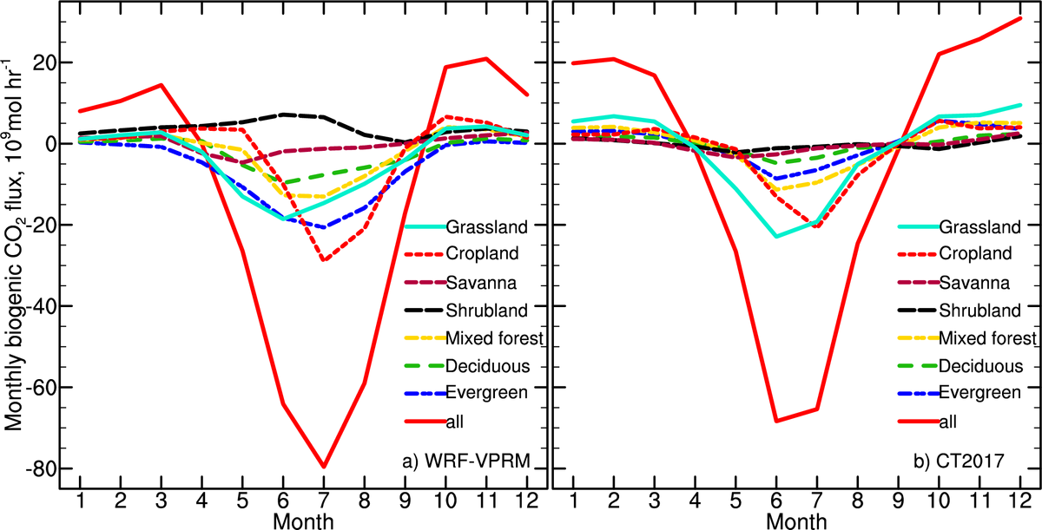
Biogenic CO₂ fluxes downscaled by WRF-VPRM vs. CarbonTracker posterior fluxes
WRF-VPRM
CT2017

Slide 12
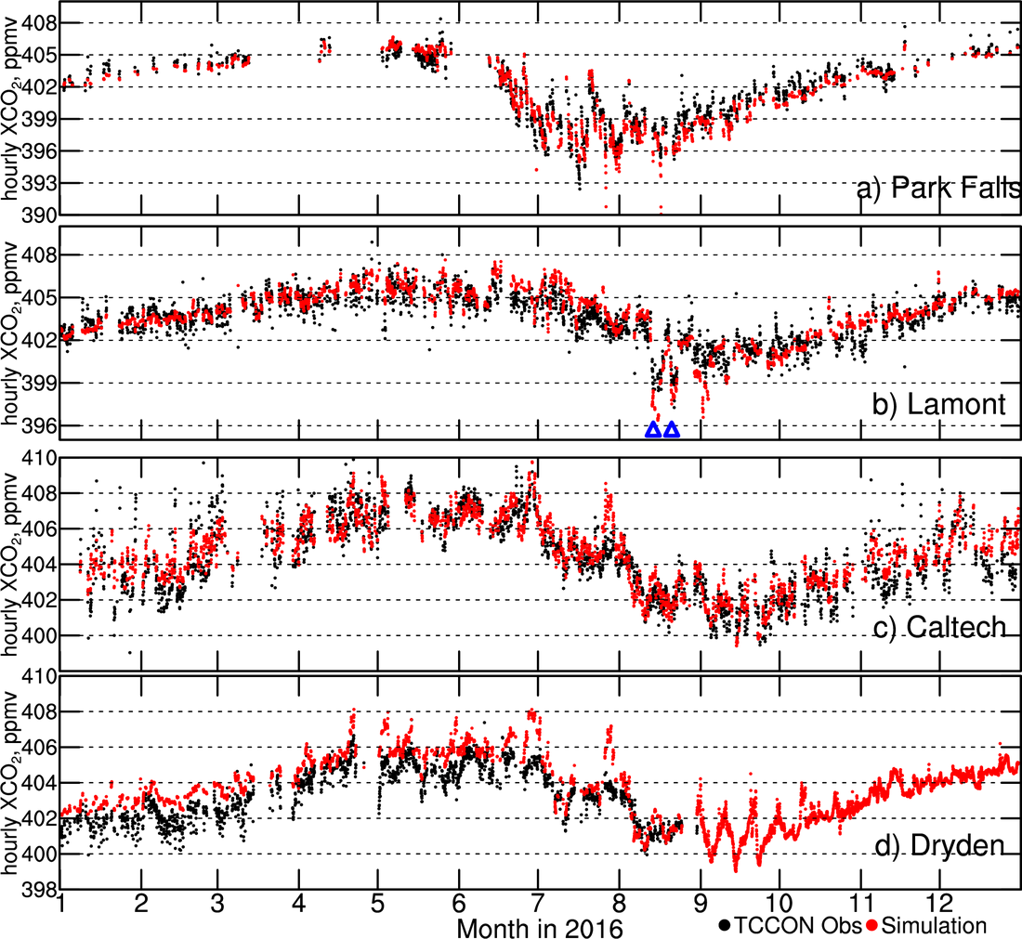
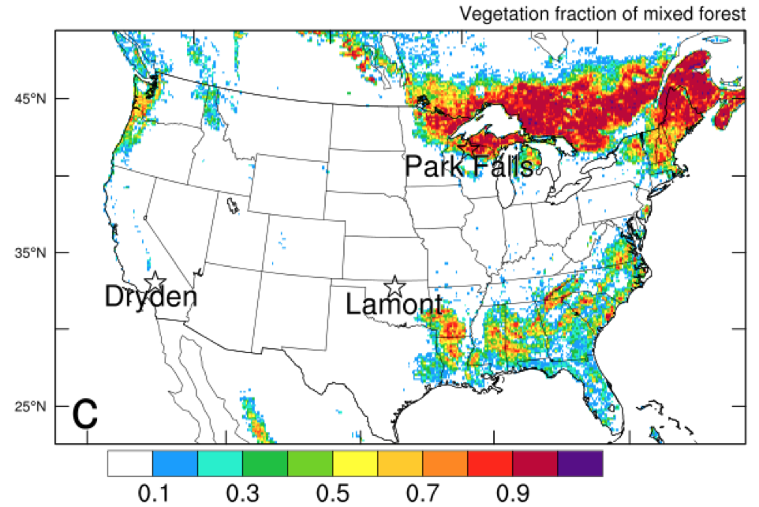
XCO₂ at the 4 TCCON sites
Bias in western boundary?
Bias in anthropogenic emission?
captures the seasonal and some episodic variation of XCO₂.

Slide 13
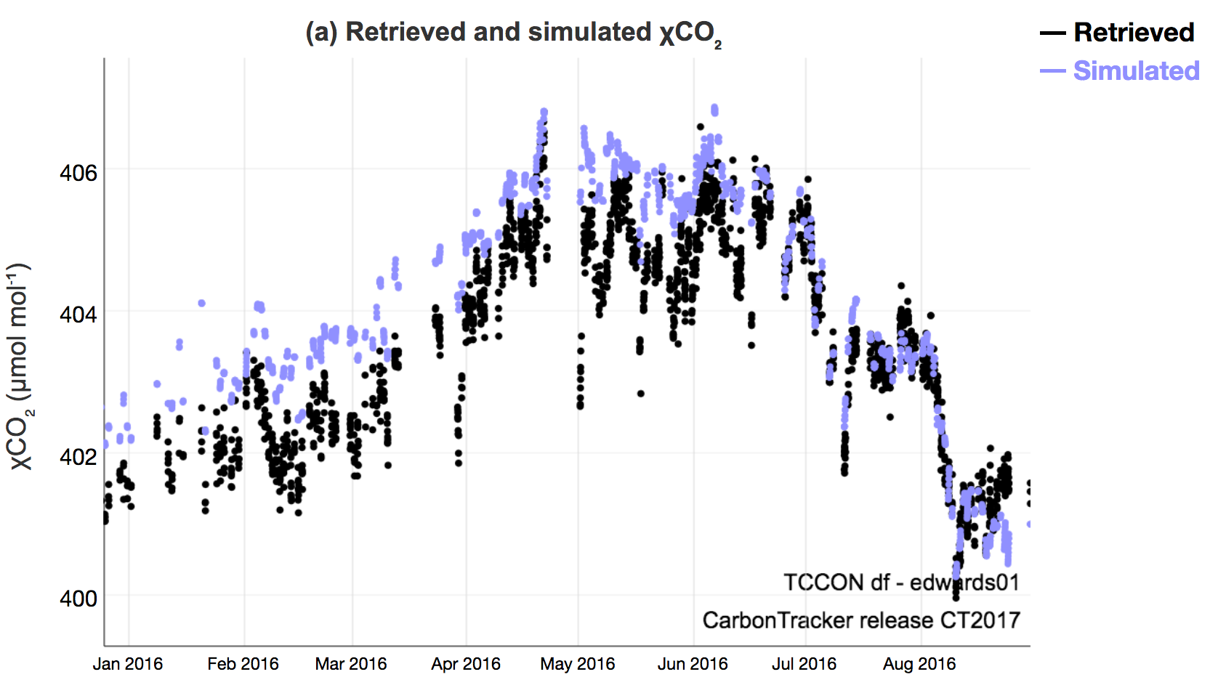
Evaluation of
CT2017
Evaluation of
WRF-VPRM
Thus, bias in western boundary partially contributed to WRF-VPRM bias?

Slide 14
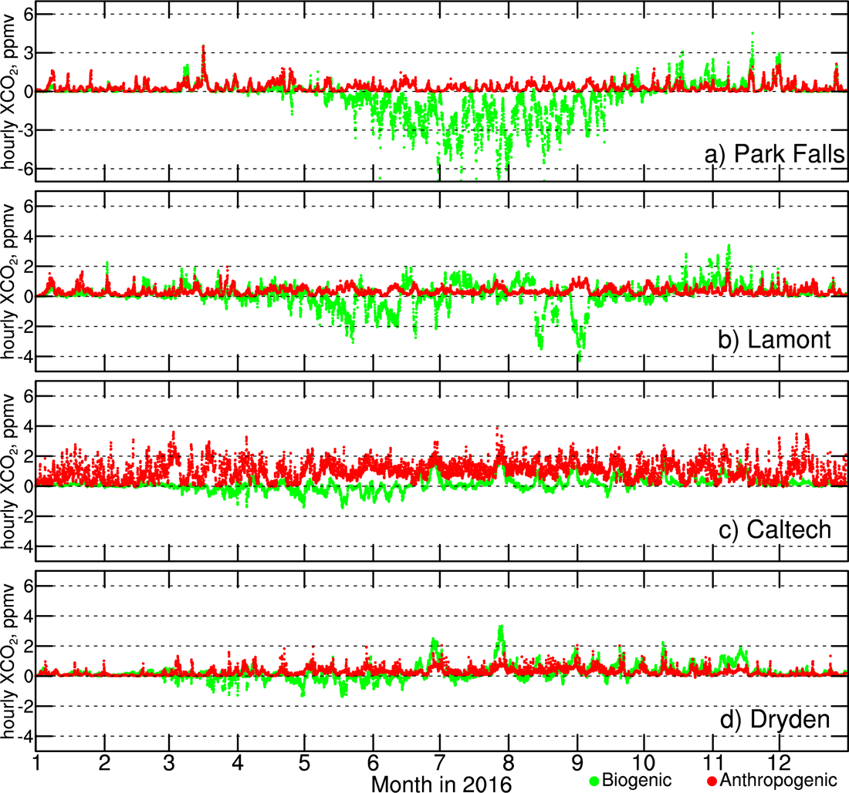
Individual contribution to XCO₂

Slide 15
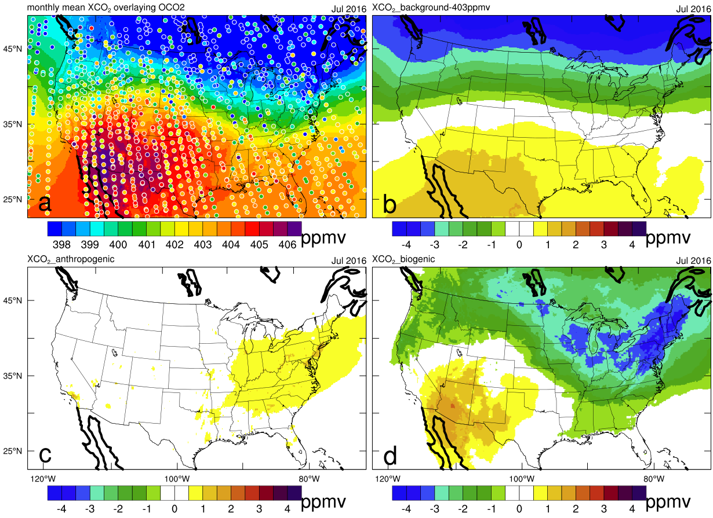
Compare with OCO-2; individual contributions
Total
Background
Anthropogenic
Biogenic

Slide 16
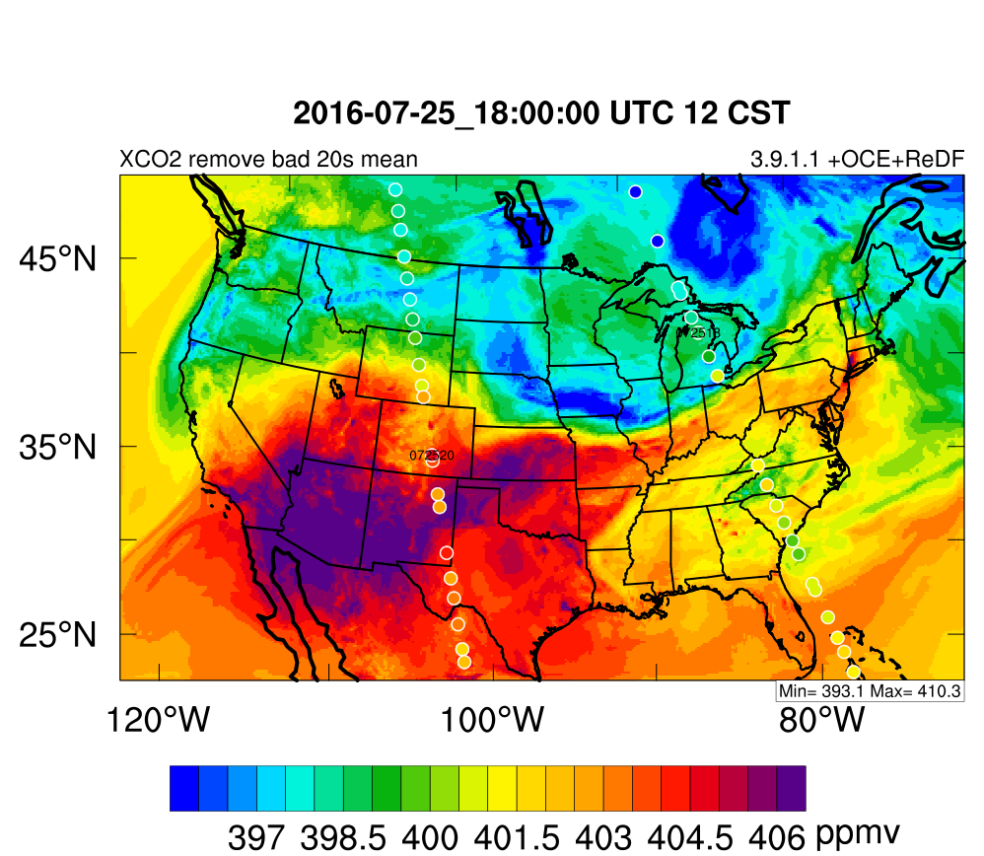
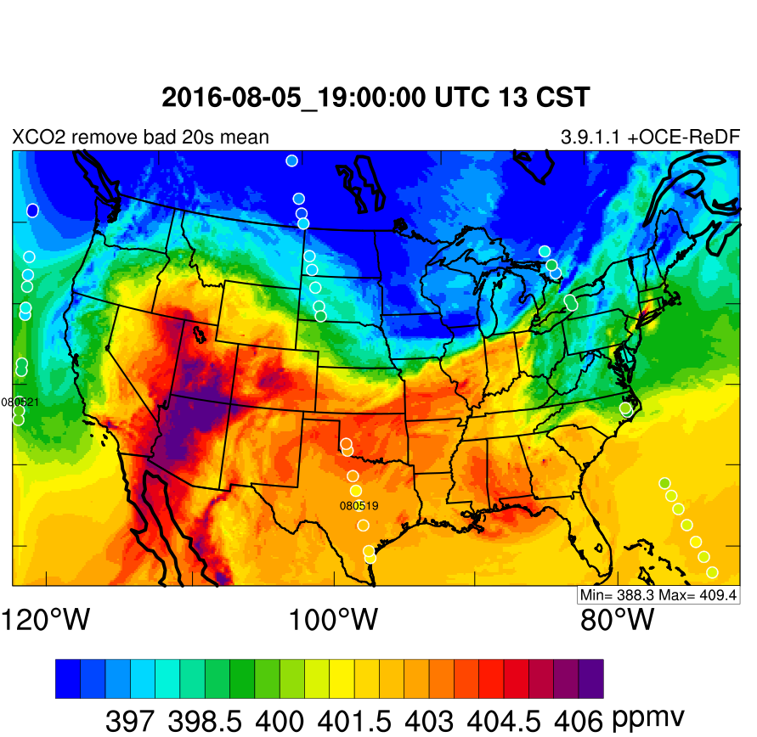
Compare with OCO-2, individual cases

Slide 17
Statistic evaluation of XCO₂ using OCO-2 data
Best performance in Summer, followed by Fall

Slide 18
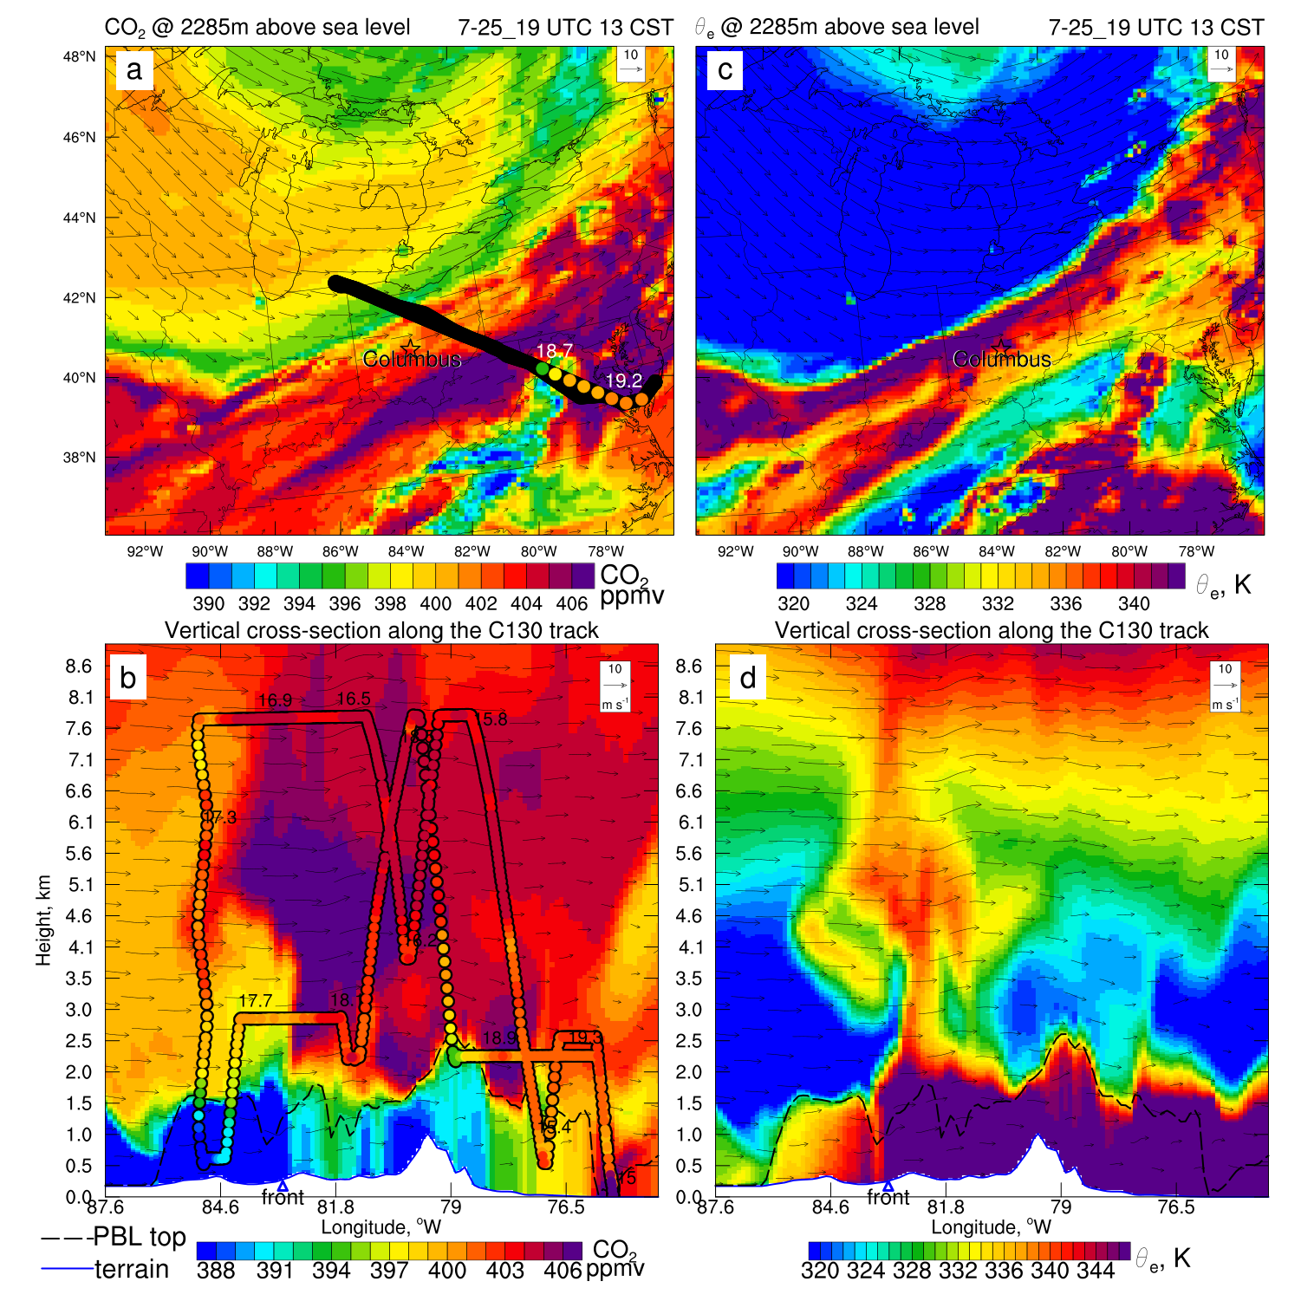
Case study
July 25
Capture the contrast across boundary layer top

Slide 19
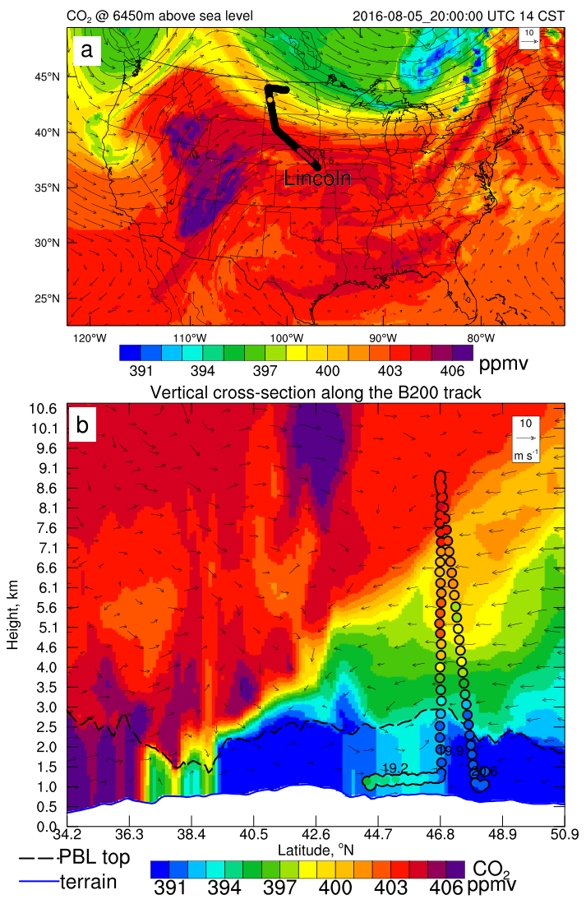
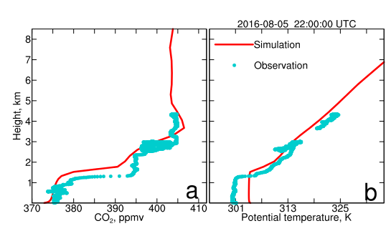
Case study, Aug 5
OCO-2 underpass

Slide 20
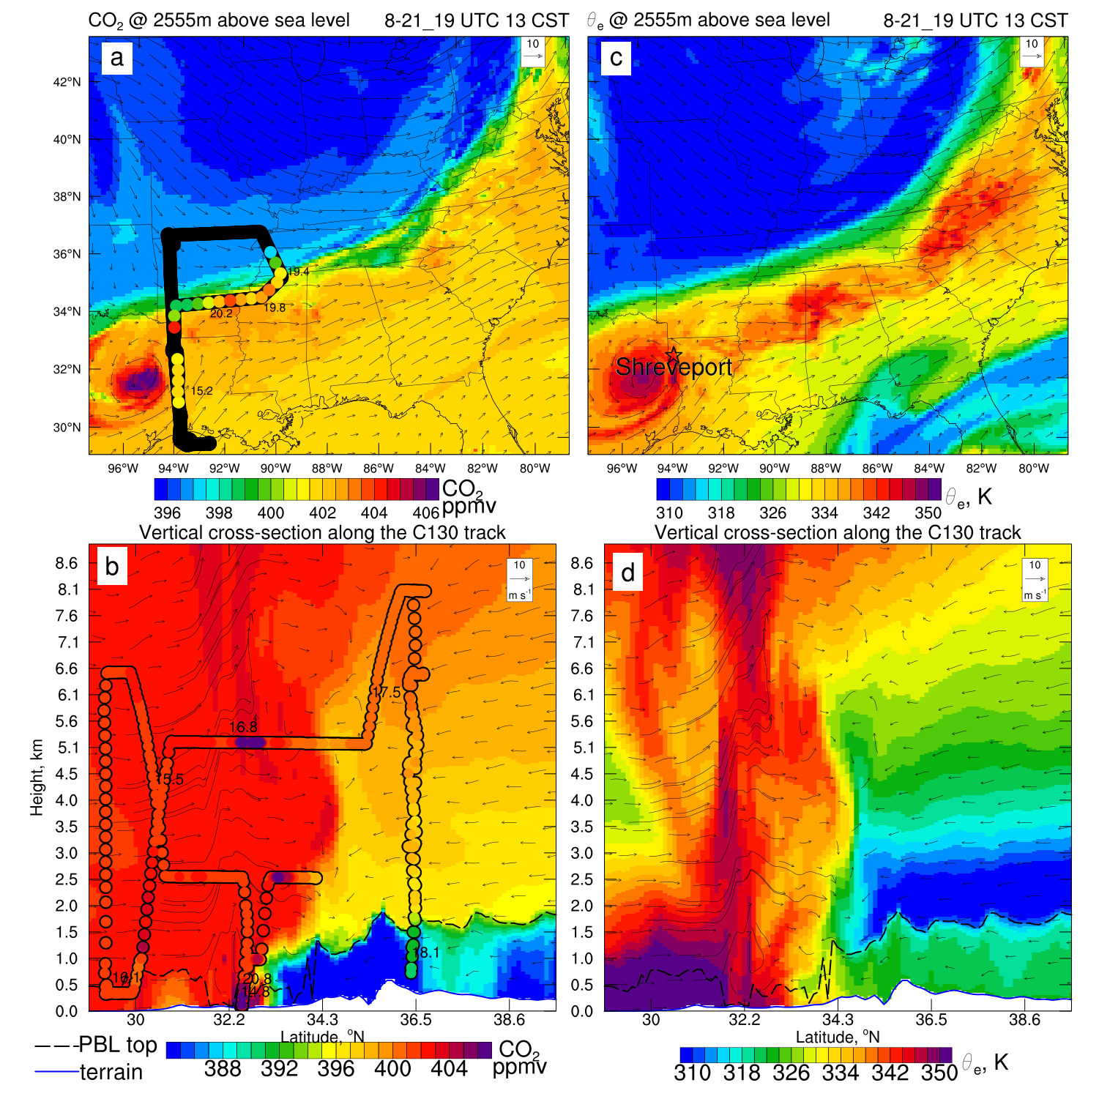
Aug 21,2016
Capture the contrast across boundary layer top,
and across cold front

Slide 21
Summary
Calibrated VPRM parameters from Hilton et al [2013] are implemented into WRF-VPRM
WRF-VPRM reasonably captures monthly variation of XCO₂ and episodic variations due to frontal passages
The downscaling also successfully captures the horizontal CO₂ gradients across fronts, as well as vertical CO₂ contrast across the boundary layer top.

Slide 22
Terrestrial CO₂ fluxes in different regions
Uncertainties in each region are large too
Asia is CO₂ sink!!

Slide 23
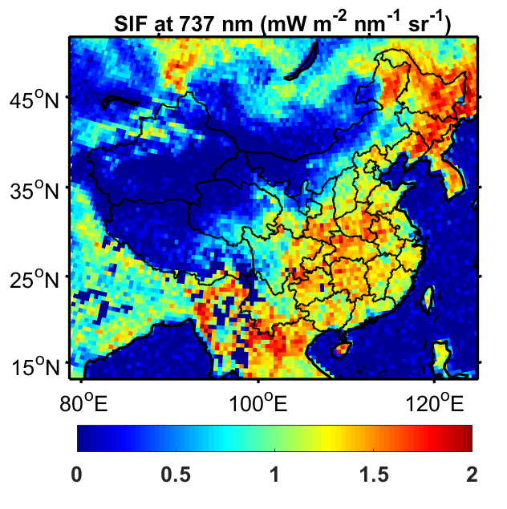
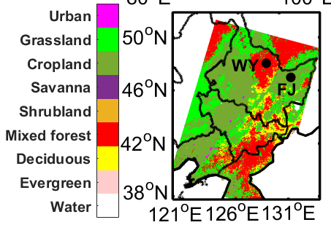
Northeast China: a major CO₂ sink
MODIS vegetation type
Mixed forest and cropland dominate in Northeast China
Crop area is still increasing!!
SIF: Sun-induced Fluorescence, proportional to photosynthesis

Slide 24

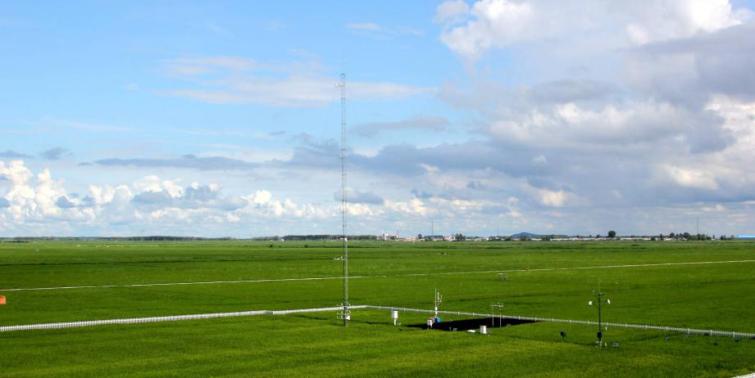
Long-term tower measurements, focusing on 2016
Observational parameters:
  1) Hourly mean CO₂ fluxes and concentrations,
  2) wind speed and direction, air temperature
  3) PAR (only at Fujin)
Observational period:
  Fujin: since 2012
  Wuying: since 2014
Wuying, mixed forest site
(131.9385°E, 47.1519°N, 345 m)
Fujin, rice paddy field
(129.2661°E, 48.2991°N, 59 m)

Slide 25
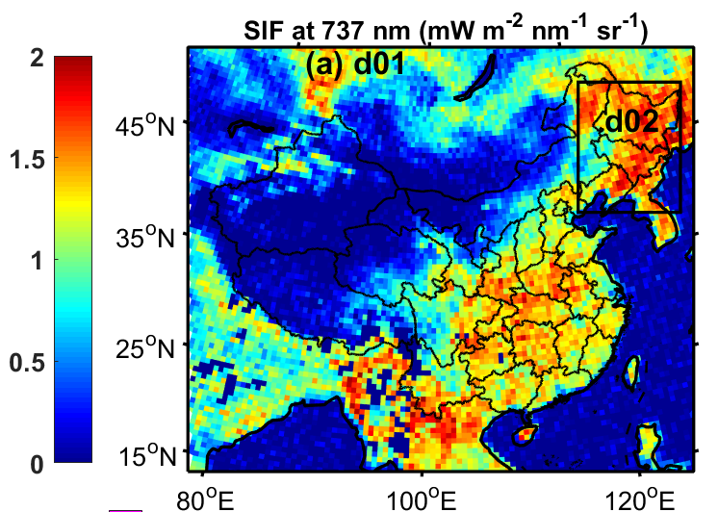
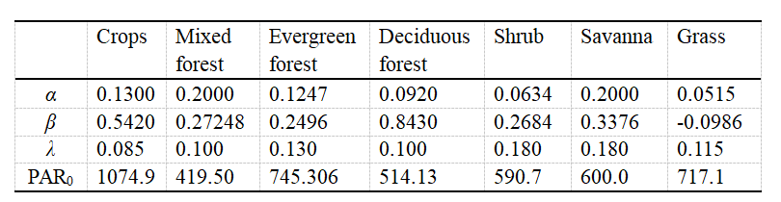
2016 downscaling using WRF-VPRM: a weather-biosphere-online-coupled model
maximum light use efficiency
water stress scale
phenology
scale
photosynthetically active radiation
Related to land surface water index (LSWI)
Roughly equal to enhanced vegetation index (EVI)
Resolution: 20 km in d01; 4 km in d02
Meteorology initial/boundary conditions: NECP/DOE R2
CO₂ initial/boundary conditions: 3º×2º CarbanTracker 2017
Anthropogenic emissions of CO₂: ODIAC
Following Hu et al. (2019) based on Hilton et al. (2013)

Slide 26
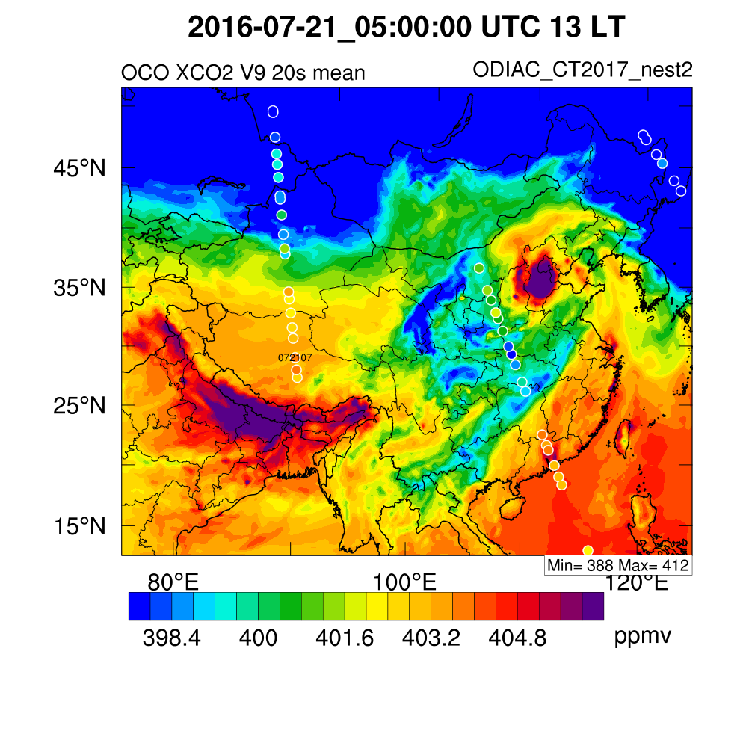
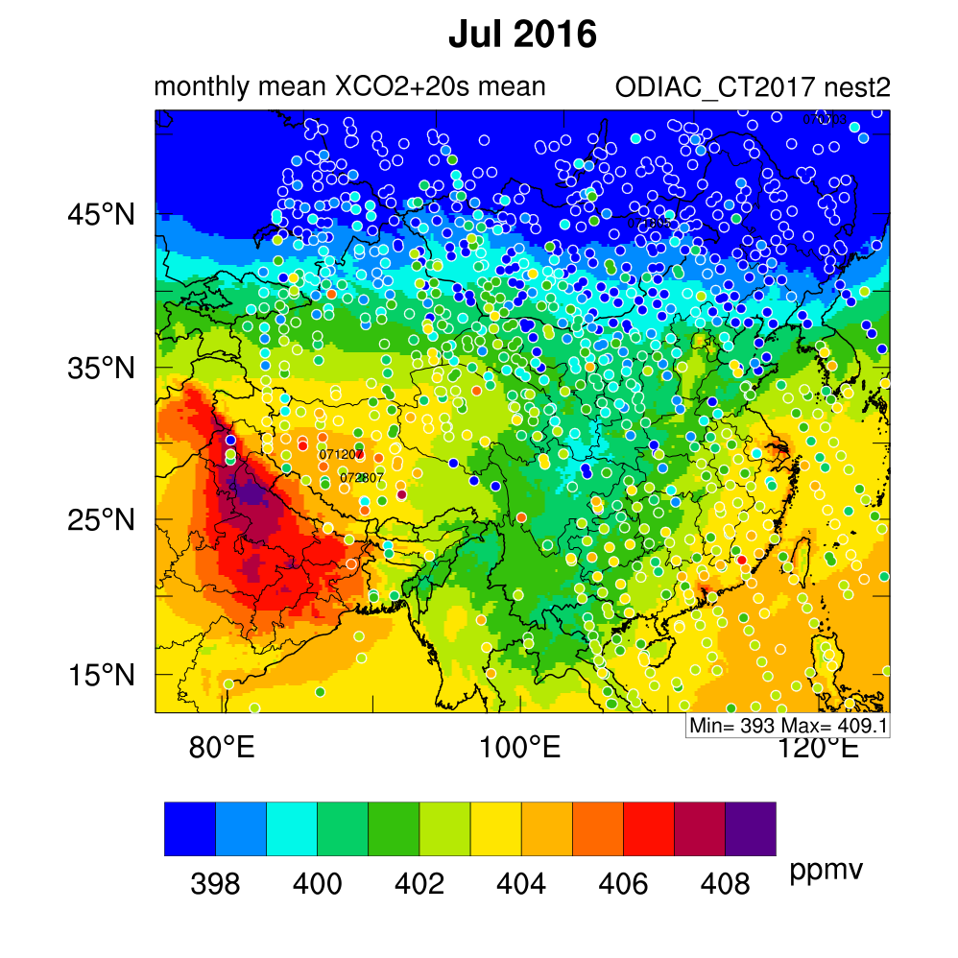
OCO-2 retrieved XCO₂ (L2 Lite Version 9)
Advantage: spatiotemporal coverage
Disadvantage: interfere with cloud and haze pollution!!

Slide 27
Seasonal variations of CO₂ fluxes and concentrations
Fujin (cropland, rice paddy)
MODIS vegetation type
R = 0.98
R = 0.87
Notes:
1) correlation between EVI and NEE; 2) seasonal variation of NEE and CO2 concentrations

Slide 28
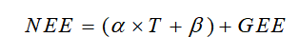
Bias of terrestrial respiration
Fujin (cropland, rice paddy)
largely subjected to the EVI
R = 0.98
Ignores leaf mass, involves EVI?
R = 0.87
Notes:
1) correlation between EVI and NEE; 2) seasonal variation of NEE and CO2 concentrations

Slide 29
Seasonal variation of CO₂ fluxes and concentrations
MODIS vegetation type
Wuying (mixed forest)
R = 0.99

Slide 30
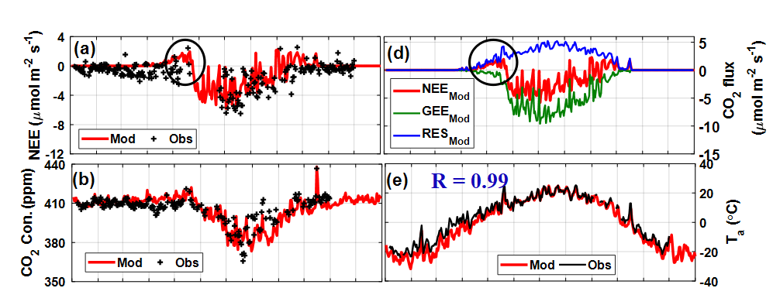
Episodic variation on October 15, 2016
Fujin (cropland, rice)
R = 0.99
Wuying (mixed forest)
Notes:
1) correlation between EVI and NEE; 2) seasonal variation of NEE and CO2 concentrations

Slide 31
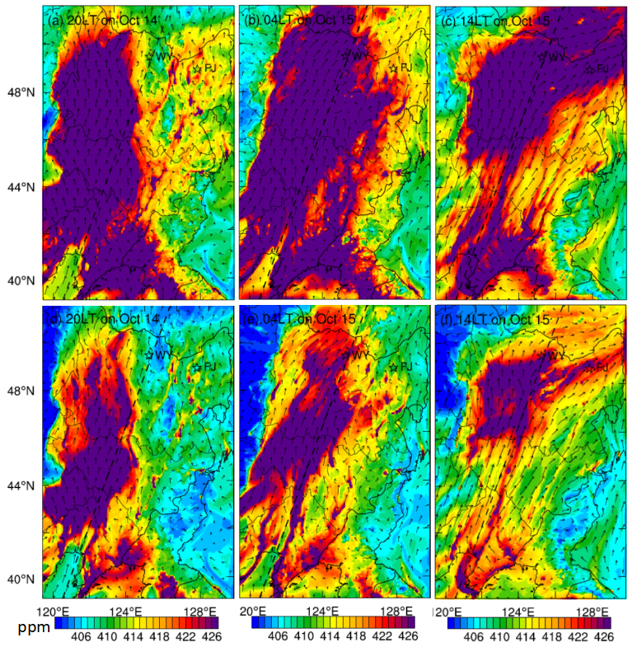
Regional transport on October 15
Anthropogenic emissions & biogenic contribution
Anthropogenic emissions only
Anthropogenic contribution: 59.4 ± 5.9% Biogenic contribution: 40.6 ± 5.9%

Slide 32
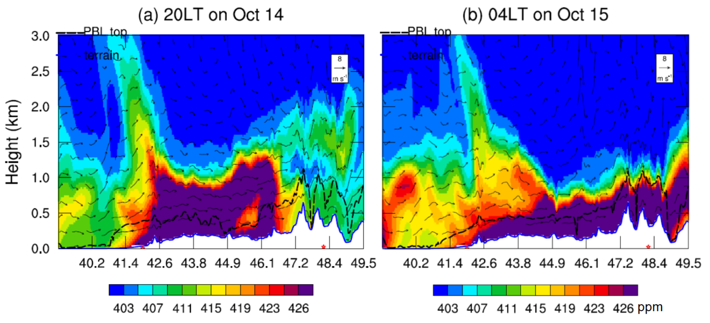
Vertical cross-section on October 15
Regional transport as well as subsidence?

Slide 33
OCO-2 retrieved XCO₂ (L2 Lite Version 9)
Advantage: spatiotemporal coverage
Disadvantage: interfere with cloud and haze pollution!!

Slide 34
Seasonal variation of XCO₂ over Northeast China
Seasonal variation range: 10 ppmv
Annual mean contribution:
anthropogenic: 0.84 ppmv
biogenic: -0.60 ppmv
32% lower than the annual level
Weak winds favors the large anthropogenic contribution of XCO₂ in summer

Slide 35
Mean diurnal variation of CO₂ fluxes and concentrations in growing season
Fujin (cropland, rice paddy)
Wuying (mixed forest)
WRF-VPRM underestimates diurnal variation range over mixed forest

Slide 36
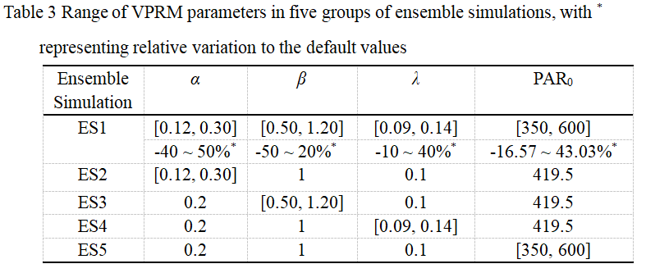
Ensemble offline VPRM simulations over mixed forest, predictability of CO₂ fluxes

Slide 37
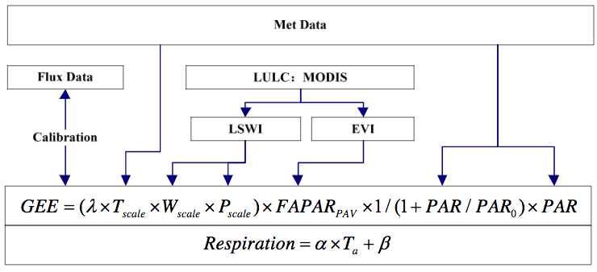
Conclusions and future work
Mixed forest is observed as a stronger CO₂ sink/source than rice paddy on average in 2016;
Negative biogenic contribution offset about 70% of anthropogenic contribution of XCO₂ over Northeast China in 2016;
The uncertainty of NEE simulation largely depends on four VPRM parameters, especially the maximum light use efficiency λ.
Future: Update VPRM in WRF, including update the GEE equation and parameters.
=
EVI
Also separate crop into C3/C4
1.25*(EVI-0.1)

Slide 38
CO₂ models
Global models:
  Chemistry transport model TM3 (Heiman, 1996), TM5 (Krol et al., 2005)
  Laboratoire de Met´eorologie Dynamique, LMDZ（Hauglustaine et al., 2004）
  ECHAM-4 (Max Planck Institute for Meteorology)
  CarbonTracker (only simulate CO₂ fluxes, not CO₂ concentrations)
Regional models:
  NCAR episodic regional chemical transport mode, HANK（Hess et al., 2000）
  Danish Eulerian Hemispheric Model, DEHM (Christensen, 1997)
  REgional MOdel, REMO(Majewski, 1991)
  DEHM-LSM (land surface model), (Geel et al., 2004)
  RAMS-SiB2(Scott Denning et al., 2003)
Reference: https://www.atmos-chem-phys.net/7/3461/2007/acp-7-3461-2007.pdf

