Slide 1
Boundary layer structure and processes, interactions with pollutants/urban
Xiao-Ming Hu
http://www.caps.ou.edu/~xhu/
CAPS, Univ. of Oklahoma
@ PBL training camp, July 1, 2019
@ Lanzhou Univ. July 9, 2019
@ METR-3513， Fall, 2024
@ ShenYang, July 16, 2025

Slide 2
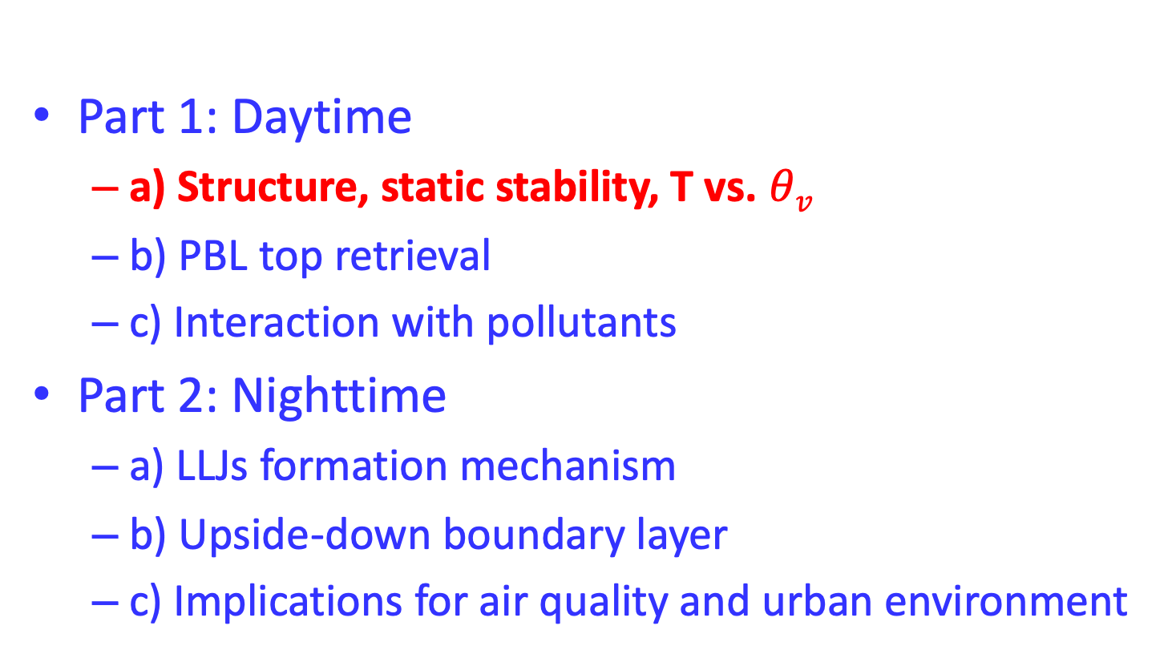
Part 1: Daytime
  a) Structure, static stability, T vs. $θv$
  b) PBL top retrieval
  c) Interaction with pollutants
Part 2: Nighttime
  a) LLJs formation mechanism
  b) Upside-down boundary layer
  c) Implications for air quality and urban environment

Slide 3
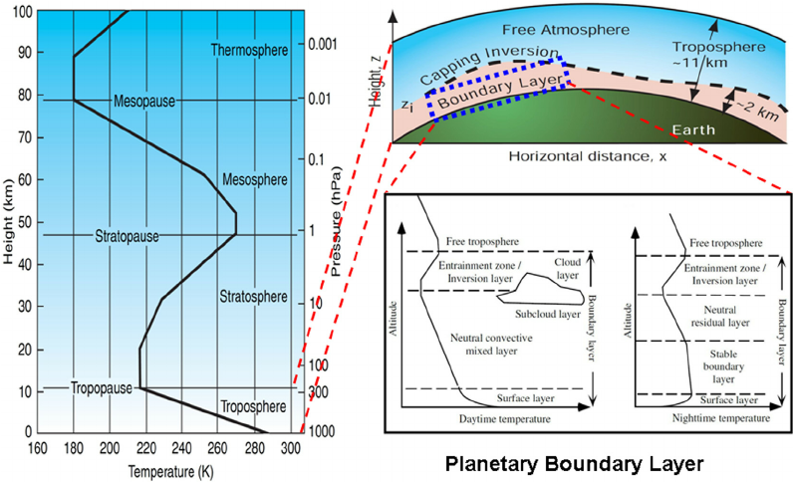
Thermodynamic Structure of the Atmosphere

Slide 4
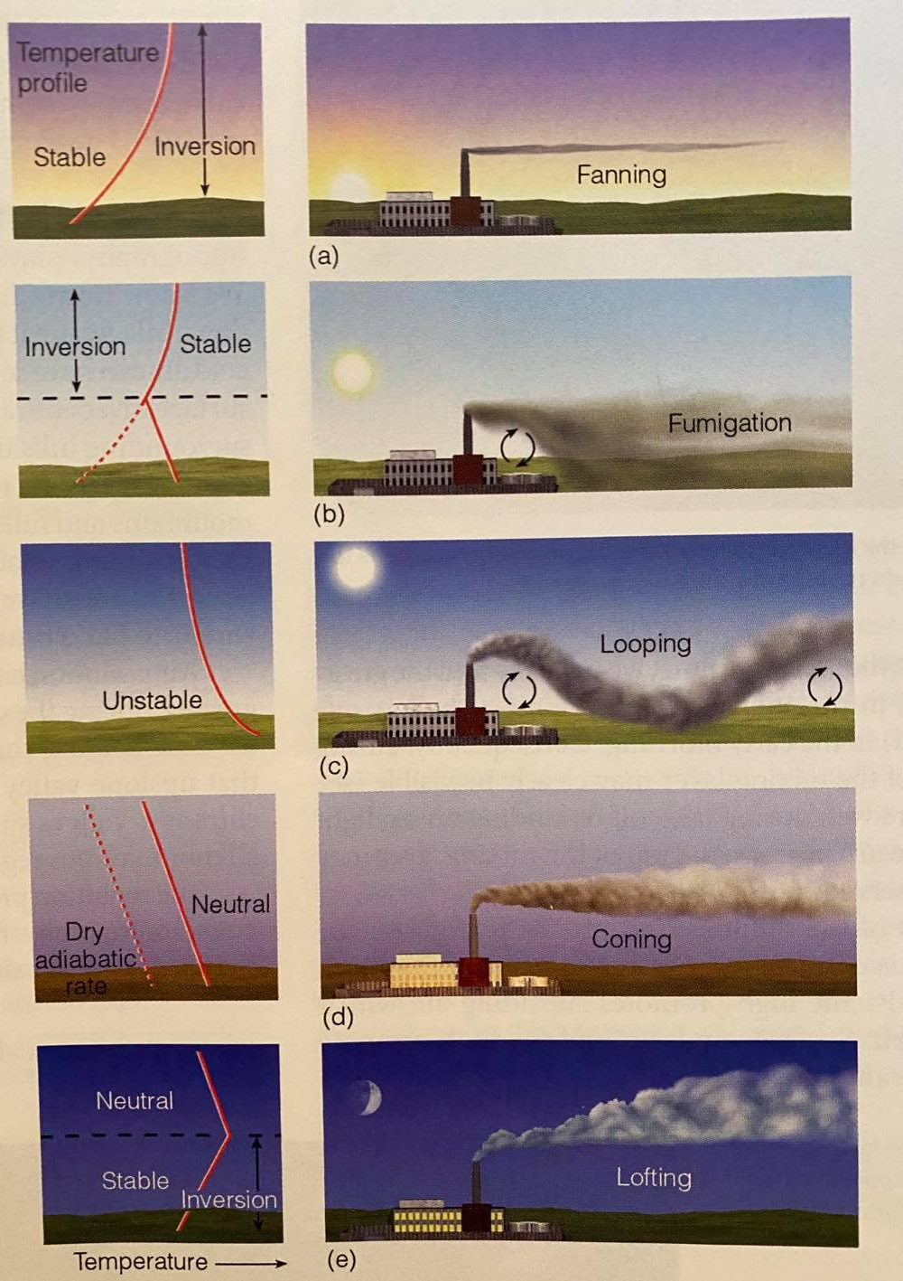
Smoke Plume Stacks
(a) Fanning: In the early morning, the winds are light, and the radiation inversion extends from the surface to well above the height of the smokestack. In this stable environment, there is little up and down motion. So, this smoke spread horizontally rather than vertically. When viewed from above, the smoke plume resembles the shape of a fan.
- A fanning plume occurs during stable conditions and is characterized by long, flat streams of pollutant emissions. Because atmospheric pressure is stable, there is neither a tendency for emissions to rise nor descend permitting (horizontal) wind velocity to transport and disperse the pollutant. Fanning plumes are usually seen during the early morning hours just before the sun begins to warm the atmosphere and winds are light

Slide 5
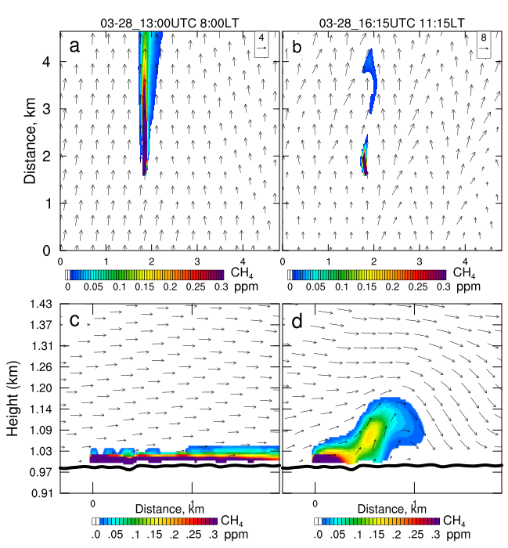
See details in poster

Slide 6
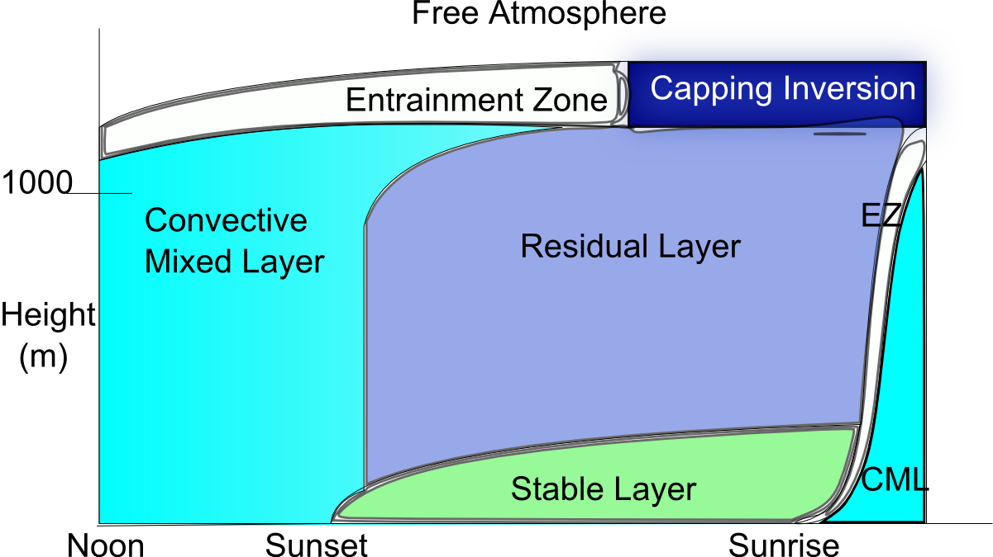
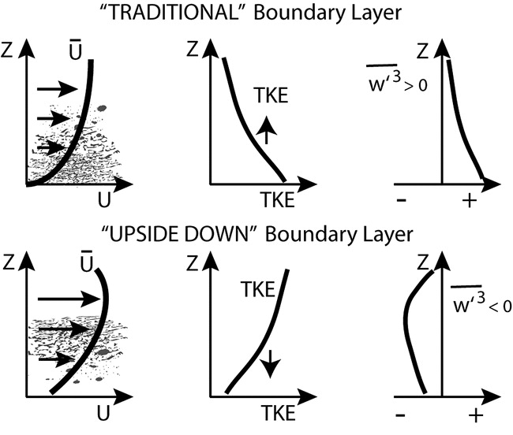
The “traditional” boundary layer
In the traditional BL, turbulence is generated at the surface and transported upward.

Slide 7
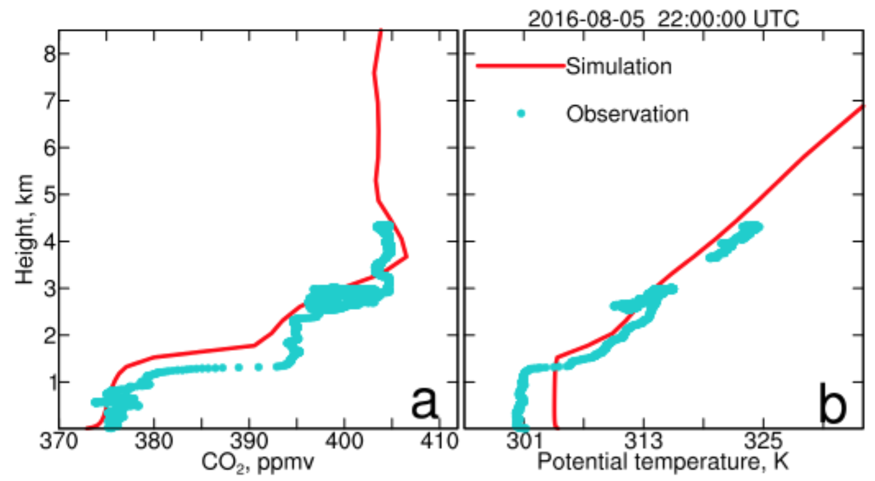
Daytime boundary layer structure
Aircraft sounding over Lincoln (Hu et al., 2020)

Slide 8
Daytime boundary layer structure
Profiles over Beltsville (Hu et al., 2012, AE)

Slide 9
Daytime boundary layer structure
Hu et al., 2012, Atmospheric Environment
PBLH is most critical for pollutant dispersion
Temperature inversion is not really important

Slide 10
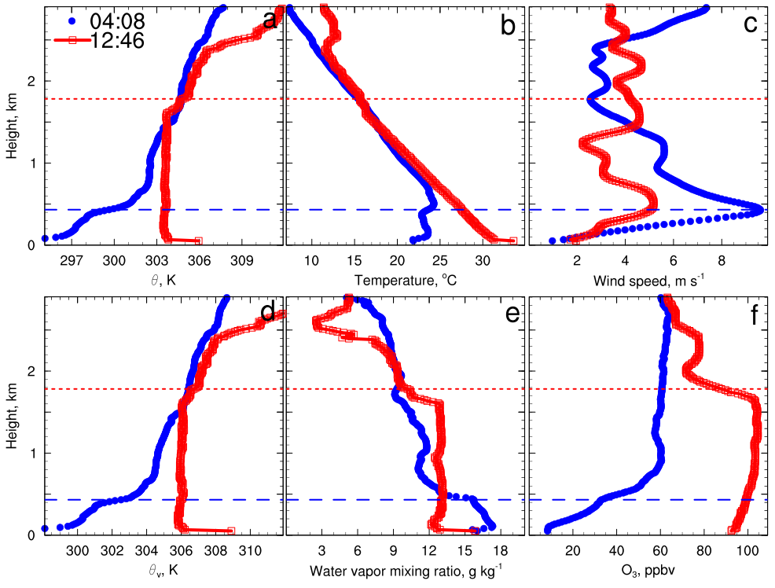
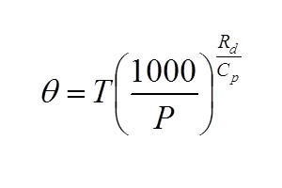
Boundary layer structure
Hu et al., 2012, Atmos. Environ
PBLH is most critical for pollutant dispersion
Temperature inversion is not really important
Hu, X.-M.,Li, X., Zhou, B., & Xue, M. (2024). Air Pollution Meteorology. Reference Module in Earth Systems and Environmental Sciences: Elsevier. doi:10.1016/B978-0-323-96026-7.00021-7 .

Slide 11
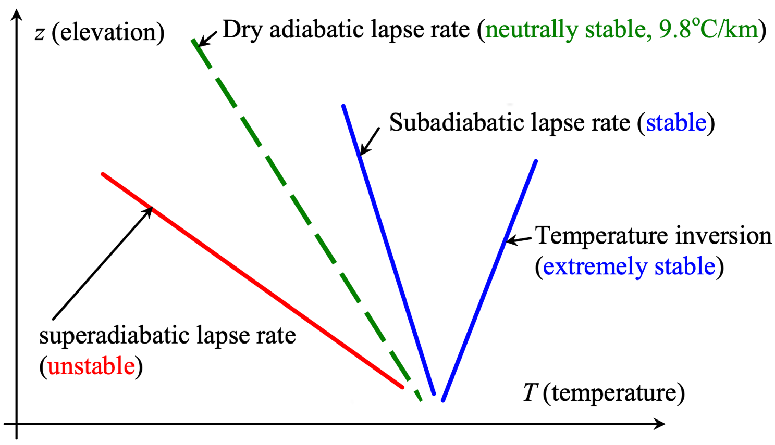
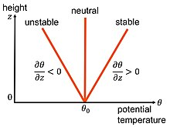
Local static stability in terms of T & ⍬

Slide 12


Local static stability in terms of $θ$
Discussing stability in $θ$is much simpler!

Slide 13
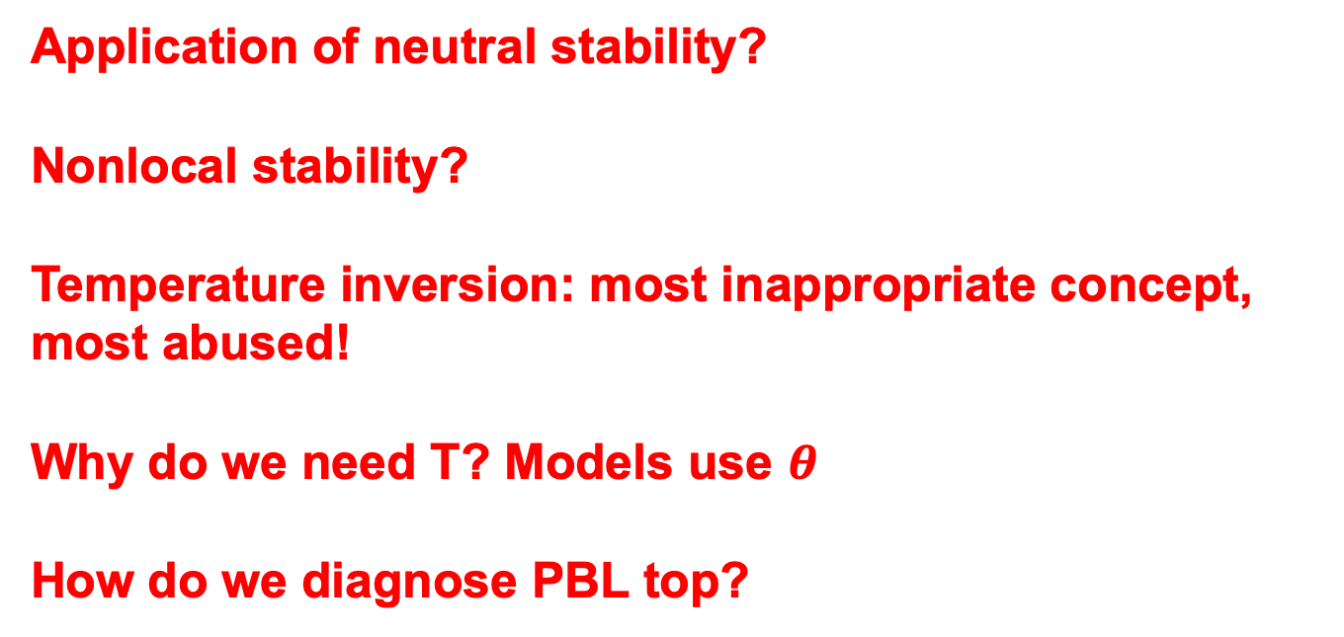

Discussion of T and $θ$
Application of neutral stability?
Nonlocal stability?
Temperature inversion: most inappropriate concept, most abused!
Why do we need T? Models use $θ$
How do we diagnose PBL top?

Slide 14
Measurements for ABLH determination
Method | Advantages | Shortcomings | Examples of References
Radiosoundings
Radiosonde | ● widely distributed all over the word ● long observation history, suited for ABLH climatology study ● providing the most accurate information of the troposphere and low stratosphere | ● infrequently, only 2-4 times per day ● in-situ observation, sparse spatial coverage | Norton and Hoidale, 1976 Cooper et al., 1994 Seidel et al., 2010 Guo et al., 2016
Tethered balloons | ● turbulence measurements possible ● the ascent velocity can be controlled according to the desired resolution | ● high cost ● limited to field campaigns with manned operation ● limited measurement range ● inapplicable in case of high wind speed or strong convection | Moores et al., 1979 Vernekar et al., 1991 Holden et al., 2000
Aricraft | ● simultaneous measurements of mean and turbulent quantities ● high sample rate | ● high cost ● limited to field campaigns ● the lowest observation height (or flight level) is restricted (security) | Galmarini and Attié, 2000 Dai et al., 2011 Dai et al., 2014
Remote sensing
Sodar | ● a simple and less expensive remote sensing system ● continuously operated in an unattended mode ● high temporal and vertical resolutions ● obtaining the height of any elevated temperature inversion layer | ● limited vertical observation range, a few hundred meters to 1 km ● reduced data availability in special weather situations (near-perfectly adiabatically stratified CBL in the afternoon) ● interpretation of the remotely-sensed structures sometimes ambiguous | Beyrich and Weill, 1993 Beyrich, 1997 Lokoshchenko, 2002 Emeis et al., 2004 Helmis et al., 2012
Microwave radiometer | ● providing good estimates of temperature and humidity in the lower troposphere with high temporal resolution | ● the vertical resolution decreases with altitude ● poor data quality in cloudy and rainy conditions | Crewell et al., 2007 Cimini et al., 2013 Saeed et al., 2015 Liu et al., 2015
Doppler Rardar wind profiler | ● continuous operation ● high temporal and vertical resolutions ● providing horizontal and vertical wind profiles with high precision | ● expensive ● invalid data at the lowest range, unable to resolve shallow ABL ● limited vertical resolution ● the SNR easily influenced by several factors such as birds and insects. ● inapplicable when signal is dominated by rain or snow | White et al., 1991 Angevine, 2000 Bianco et al., 2002
Lidar | ● operated continuously in an almost automated status ● observing vertical distribution of the aerosols with high temporal resolution and wide vertical spatial coverage ● a great number of aerosol lidars deployed and established networks all over the world | ● limited data quality near surface because of the blind zone ● the ABLH determination easily interfered by multiple aerosol layers (advected or elevated) or cloud layers | Steyn et al., 1999 Davis et al., 2000 Sawyer and Li, 2013 Pal et al., 2013 Toledo et al., 2017

Slide 15
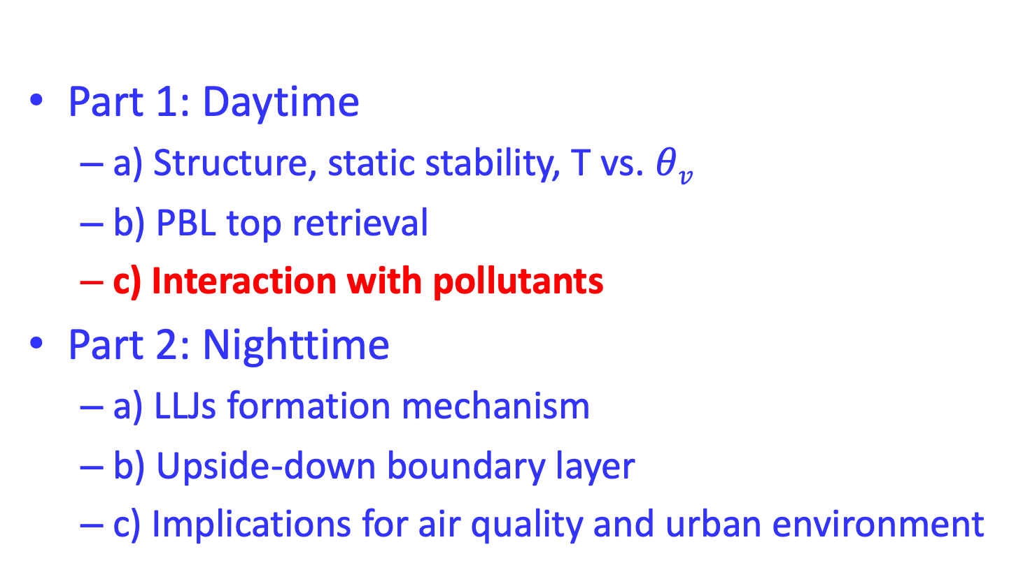
Part 1: Daytime
  a) Structure, static stability, T vs. $θv$
  b) PBL top retrieval
  c) Interaction with pollutants
Part 2: Nighttime
  a) LLJs formation mechanism
  b) Upside-down boundary layer
  c) Implications for air quality and urban environment

Slide 16
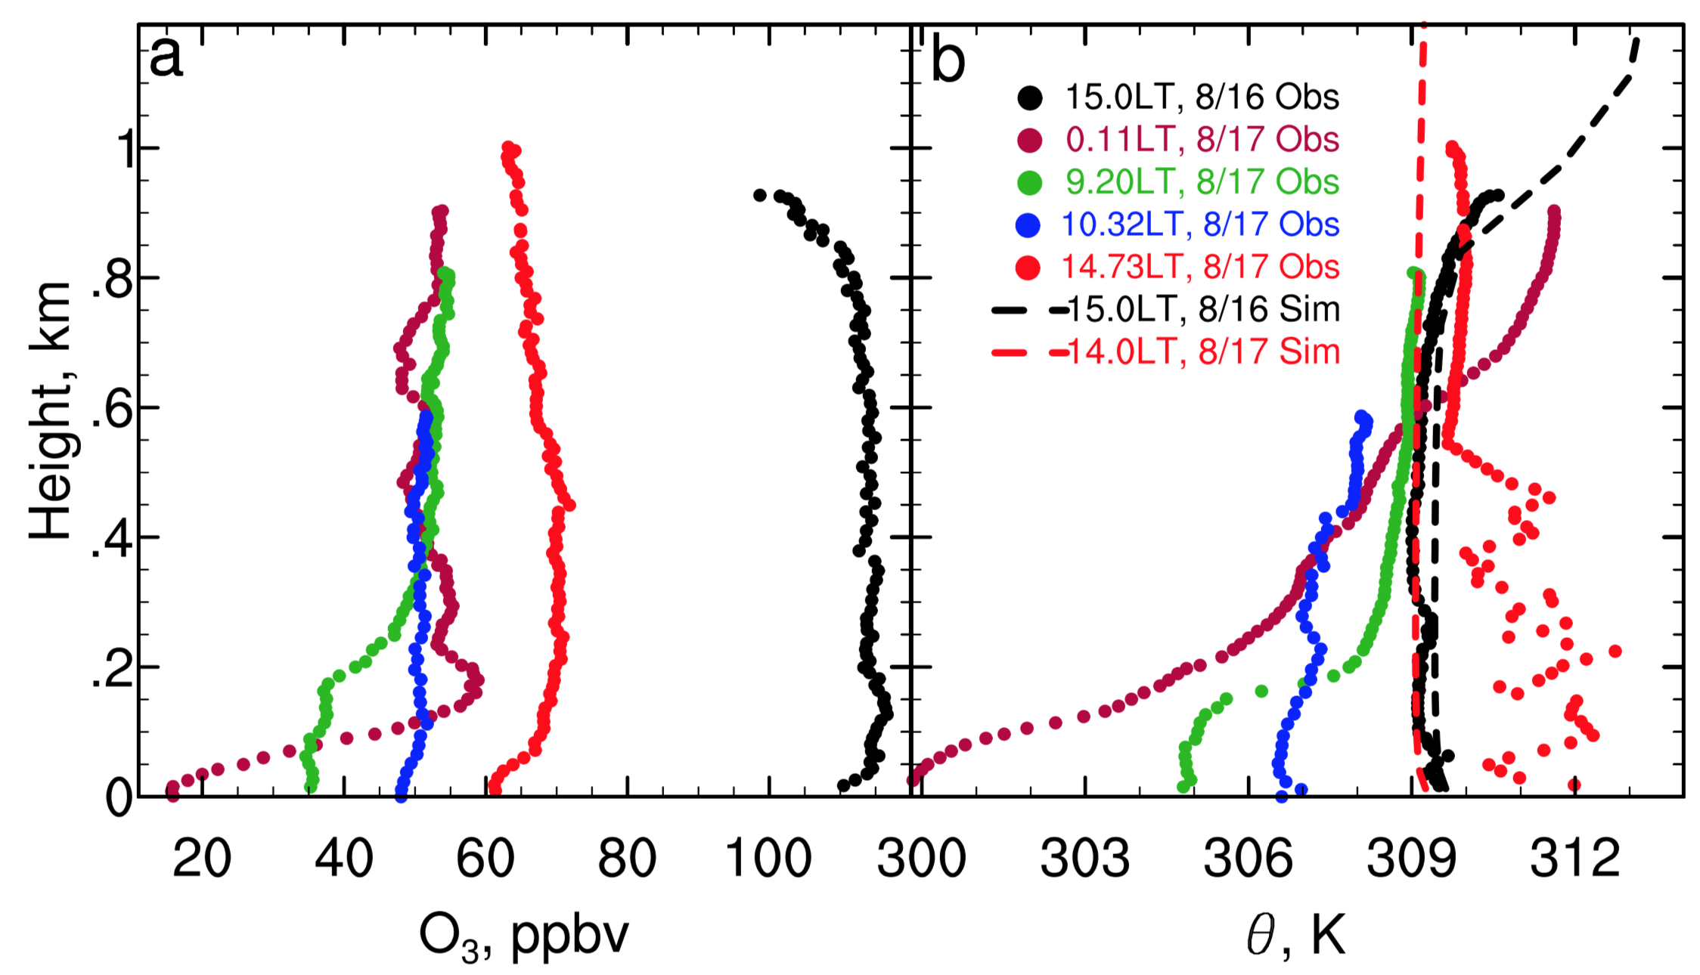
Impact of PBL height on pollutants
Low PBLH led to high O₃ on 8/16 (Hu et al., 2014)

Slide 17
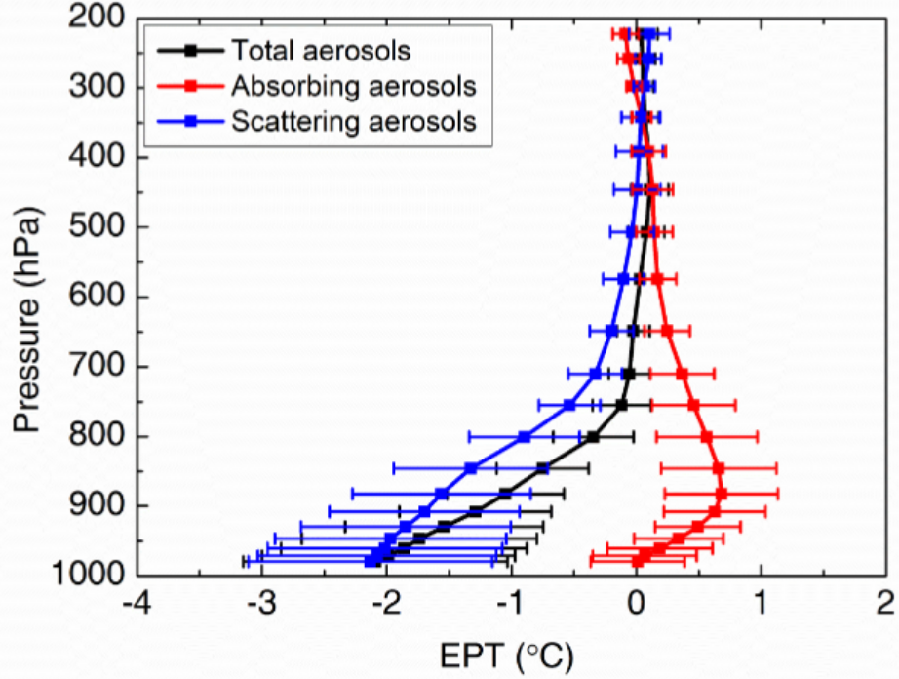
Impact of pollutants on CBLs
Aerosol effects make CBLs more stable? Show me $θ$profile for one case!
http://onlinelibrary.wiley.com/doi/10.1002/2016JD026309/epdf, which uses WRF/Chem simulations to show that aerosols make lower troposphere more stable

Slide 18
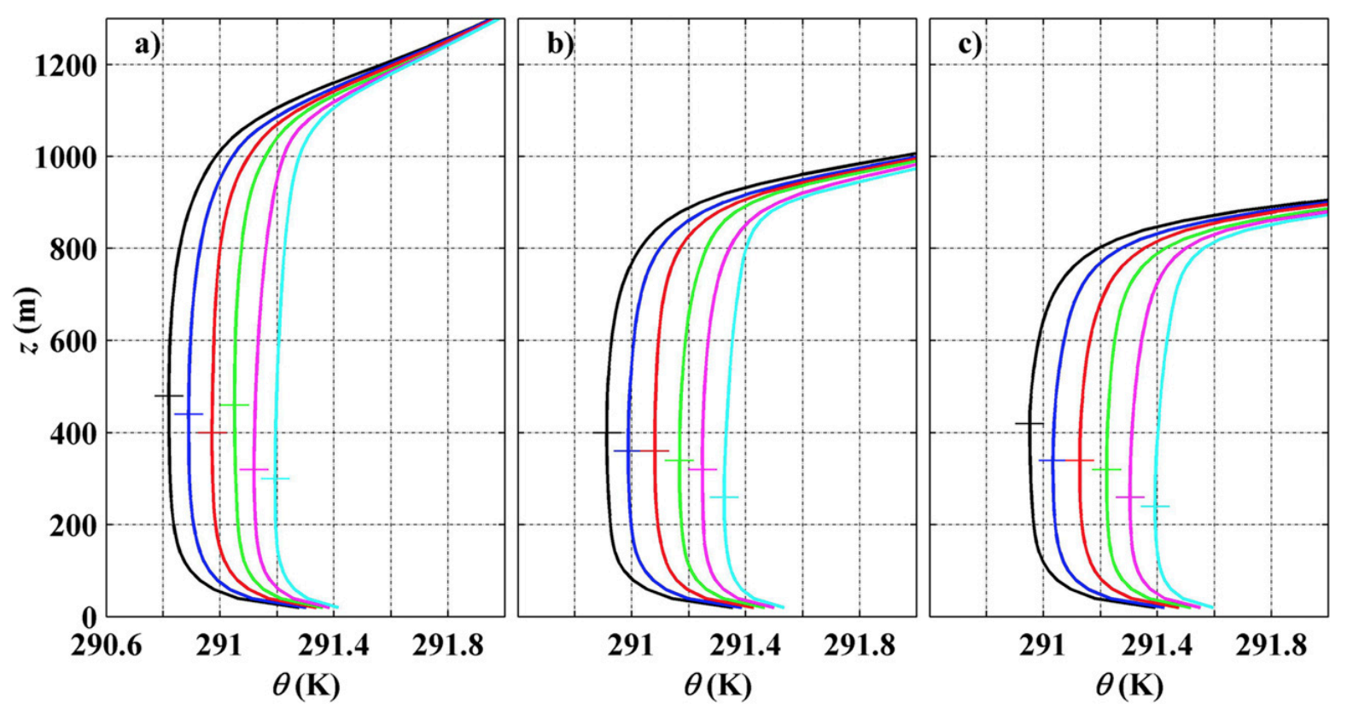
Impact of pollutants on CBLs
Aerosol effects make CBLs more stable?
Liu, Fedorovich, Huang, Hu et al. (2019, JAS)

Slide 19
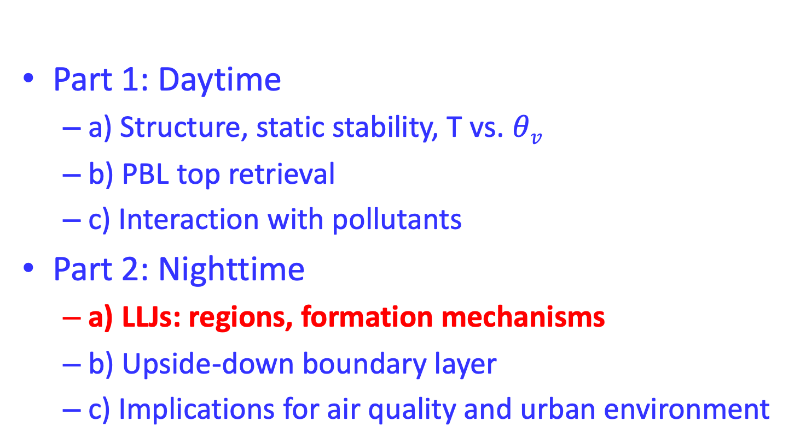
Part 1: Daytime
  a) Structure, static stability, T vs. $θv$
  b) PBL top retrieval
  c) Interaction with pollutants
Part 2: Nighttime
  a) LLJs: regions, formation mechanisms
  b) Upside-down boundary layer
  c) Implications for air quality and urban environment

Slide 20
LLJs over the Great Plains
Hu et al. (2013,JAMC)

Slide 21
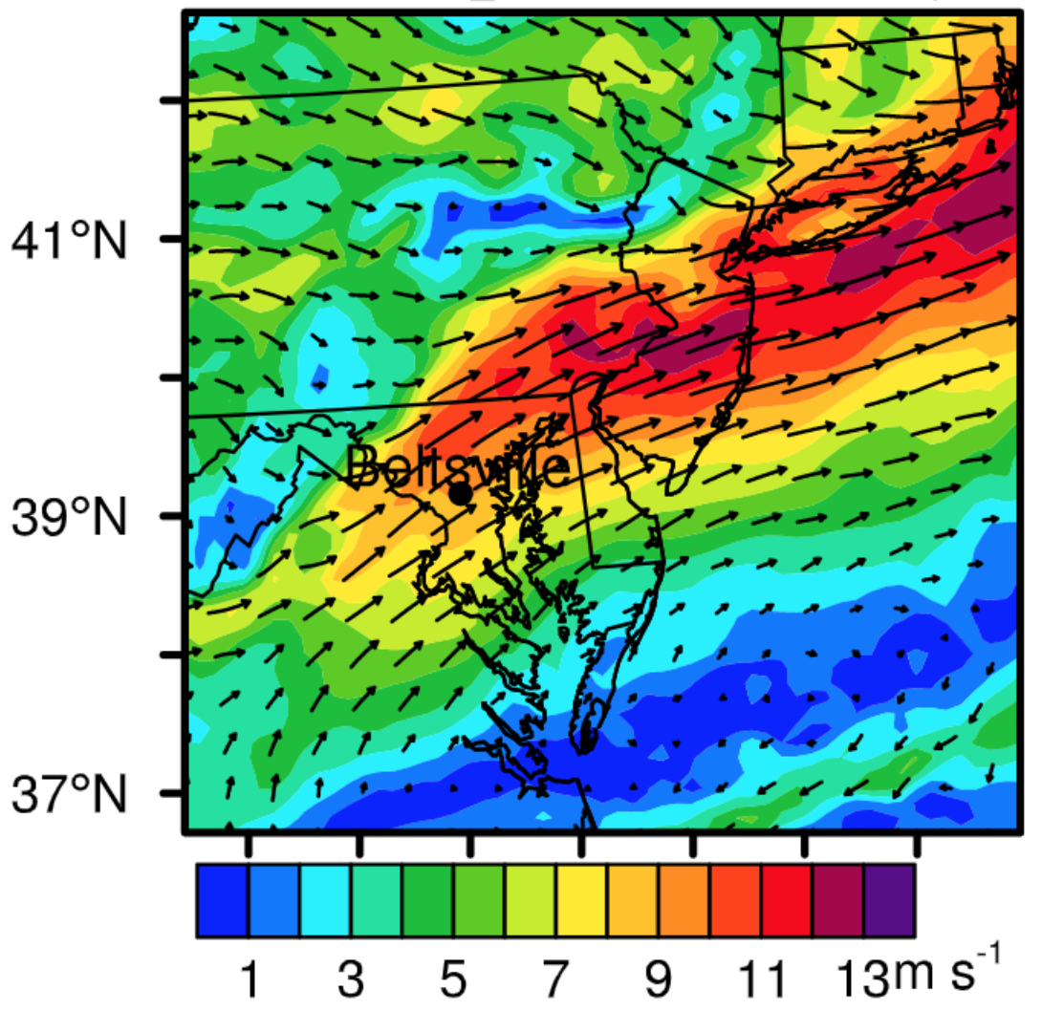
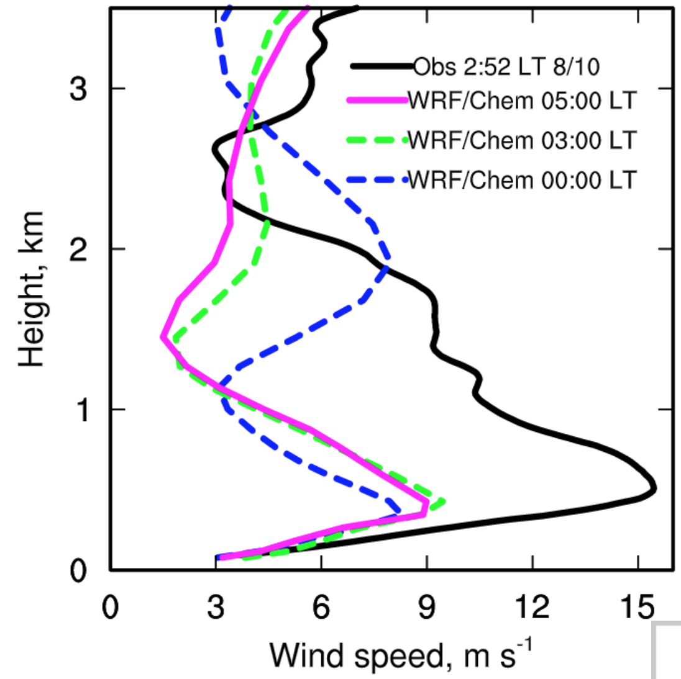
LLJs over the US eastern coast
Factors contributing to LLJs:
Inertial oscillation
Thermal wind
Hu et al. (2013, AE)

Slide 22
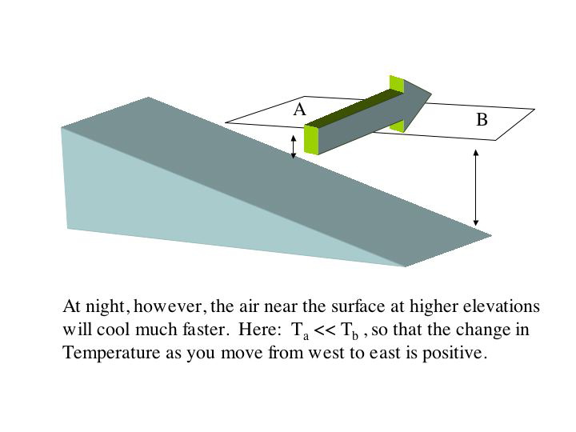
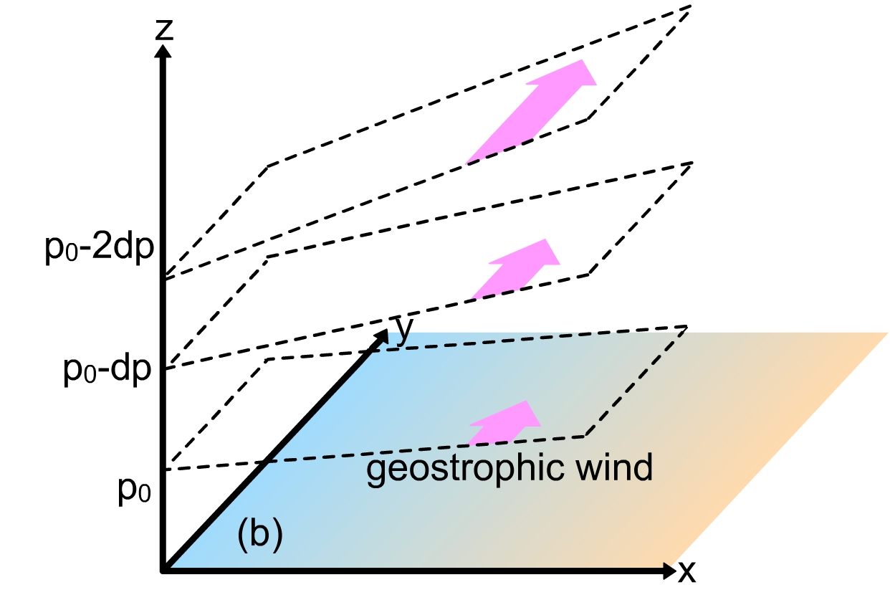
LLJs formation mechanism(1): thermal wind
Cold
Warm
Thermal wind is actually vertical shear of horizontal wind speed

Slide 23
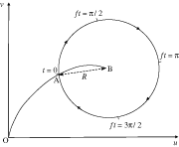
LLJs formation mechanism(2): inertial oscillation
The premise of inertial oscillation is significant decrease of turbulence during the early evening transition. So weaker turbulence, strong decoupling favor LLJs development in this theory. Inertial oscillation also cannot explain LLJ location preference.

Slide 24
Inertial oscillation:1D WRF results
(Hu, unpublished)

Slide 25
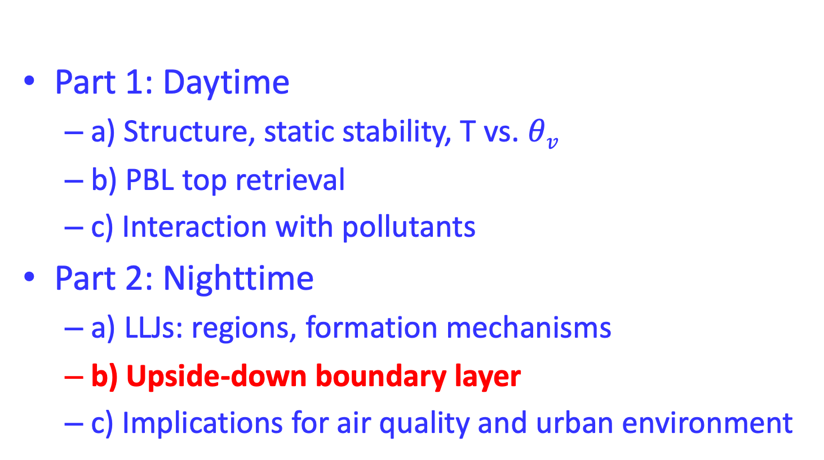
Part 1: Daytime
  a) Structure, static stability, T vs. $θv$
  b) PBL top retrieval
  c) Interaction with pollutants
Part 2: Nighttime
  a) LLJs: regions, formation mechanisms
  b) Upside-down boundary layer
  c) Implications for air quality and urban environment

Slide 26
The “upside-down” boundary layer
In the upside-down BL, turbulence is generated aloft and transported downward (Banta et al., 2006).

Slide 27
Upside-down boundary layer, case
Lidar data from the 2003 Joint Urban campaign (Klein, Hu, 2016, BLM)

Slide 28
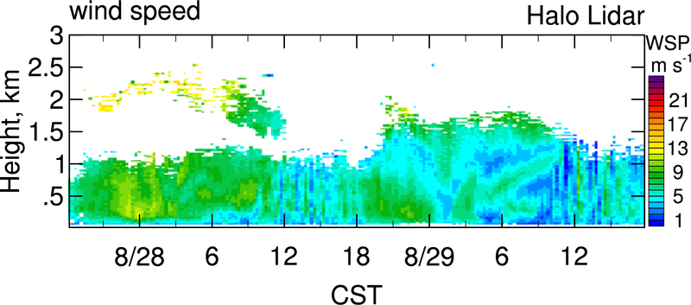
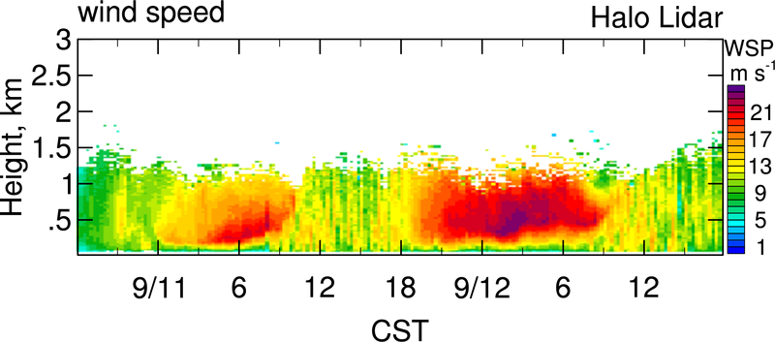
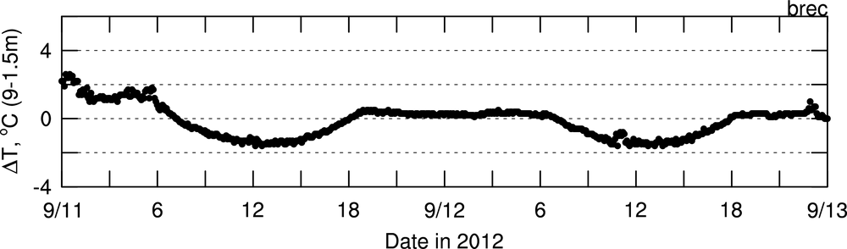
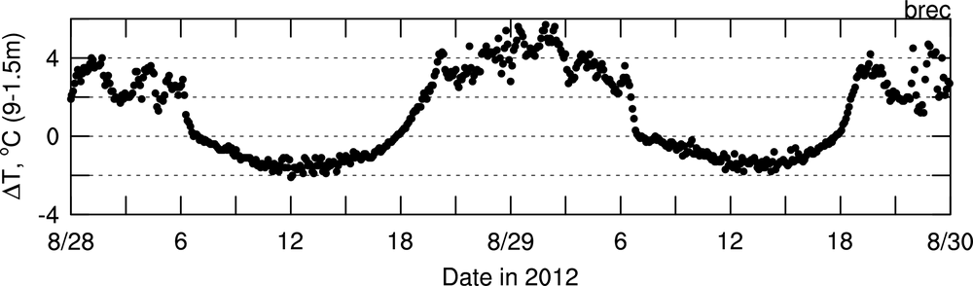
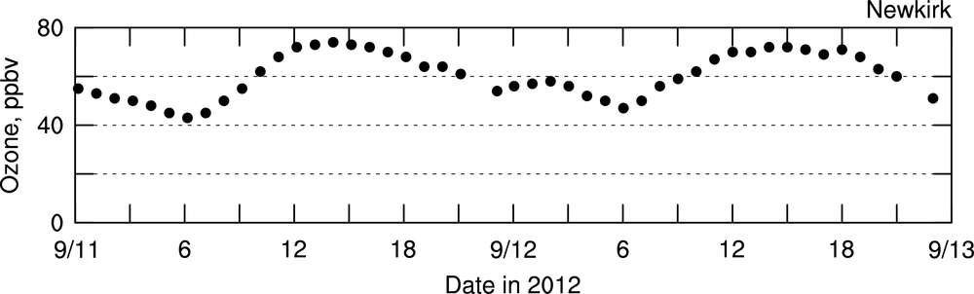
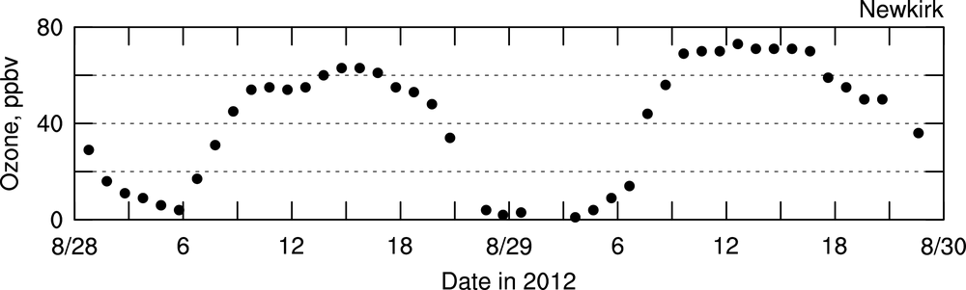
More LLJ/upside-down cases
Strong/weak LLJs lead to coupling/decoupling (Hu, unpublished)

Slide 29
Nighttime boundary layer structure: case 1
Hu and Xue (2016, MWR)

Slide 30
Nighttime boundary layer structure: case 2
How to diagnose nighttime PBL height?
Klein, Hu (2016, BLM)

Slide 31
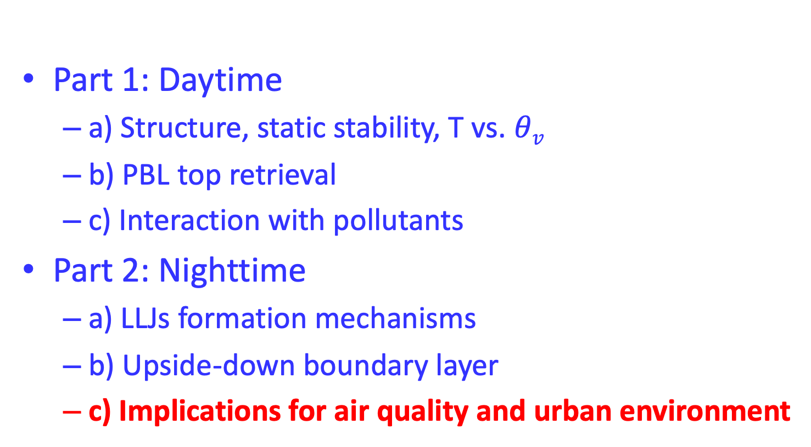
Part 1: Daytime
  a) Structure, static stability, T vs. $θv$
  b) PBL top retrieval
  c) Interaction with pollutants
Part 2: Nighttime
  a) LLJs formation mechanisms
  b) Upside-down boundary layer
  c) Implications for air quality and urban environment

Slide 32
The upside-down BL forms under certain circumstances, e.g., in the presence of LLJs and clouds (Hu et al., 2011, 2012, 2013a,b)
Impact of LLJs on O₃ in the eastern coast (Hu et al., 2013a)
Impact of LLJs on UHI in the Great Plains (Hu et al., 2013b)

Slide 33
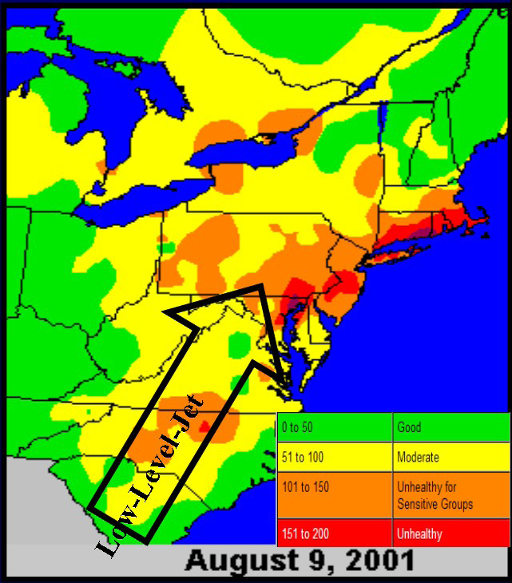
Impact of LLJs on O₃ in the eastern coast (Hu et al., 2012, 2013a)
High O₃ episodes and LLJs occur frequently in the eastern costal area.
Figure: Air quality index during an ozone episode,
Ryan and Piety, (2001)

Slide 34
LLJs formation in the eastern coast
Cold
Warm
Thermal wind contributed to the formation of the Mid-Atlantic costal LLJs
The meridional variation of the Coriolis parameter may also accelerate LLJs

Slide 35
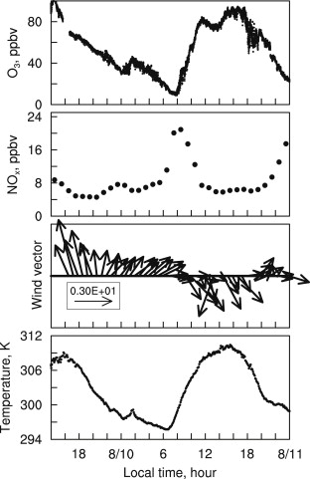
Case study of August 10, 2010,
Observation
The LLJ played an important role in vertical O₃ redistribution (Hu et al., 2013a)

Slide 36
Case study of August 10, 2010
Nocturnal O₃ maxima occurred concurrently at multiple sites along the corridor and advection can not explain (Hu et al., 2013a)

Slide 37
Case study of August 10, 2010,
1D simulations
Control : Calm condition, no LLJ
Sensitivity: with LLJ
The 1D simulations capture the main features associated with the LLJ.

Slide 38
Simulated profiles of O₃ w/o & with LLJ
Calm condition
With LLJ
LLJ reduces the RL O₃ substantially. Downward transported O₃ is removed near the surface by dry deposition and chemistry reactions. Consequently the BL O₃ on the following day is reduced.

Slide 39
Time-height diagrams of simulated O₃
Calm condition
With LLJ
The RL is not a reservoir of O₃ in the presence of a strong LLJ (Hu et al., 2013a)

Slide 40
The upside-down BL forms under certain circumstances, e.g., in the presence of LLJs and clouds (Hu et al., 2011, 2012, 2013a,b)
Impact of LLJs on O₃ in the eastern coast (Hu et al., 2013a)
Impact of LLJs on UHI in the Great Plains (Hu et al., 2013b)

Slide 41
UHI is prominent during the nighttime
Nighttime
Daytime
LLJs occur frequently in this
region, must play some roles.
Red dots around OKC:
Six rural sites

Slide 42
Factors affecting UHI intensity
Intrinsic characteristics of a city
  E.g., canyon geometry, thermal properties of the fabric, anthropogenic heat
External meteorological factors
  E.g, cloud, wind, radiation
Our study will demonstrate the dominant effect of LLJs on UHI intensity
in the Oklahoma City (OKC) metro area

Slide 43
Relationship between LLJs and nocturnal UHI intensity
LLJ strength: maximum wind speed of a LLJ
Nocturnal UHII: mean T difference between
urban and rural area during nighttime
LLJs modulate nocturnal UHI intensity

Slide 44
Two different episodes
Strong UHI
Weak UHI
UHI is primarily a nocturnal problem and its day-to-day variation is significant

Slide 45
Two different episodes: temperature profiles
Near surface thermal structure is different, will investigate the reason and effect

Slide 46
Stronger LLJs leads to stronger mixing
Stronger LLJs=>stronger mixing in a deeper BL=>nearly neutral BL

Slide 47
WRF simulation: Different vertical T gradients dictate UHI intensity
Stronger vertical T gradients lead to larger UHI intensity

Slide 48
Relationship between inversion strength and UHI intensity
Inversion strength is a good indicator of UHI intensity

Slide 49
Conclusions
The residual layer may not be a reservoir of pollutants in some cases (e.g., strong LLJs).
LLJs play important roles in modulating UHI.
Question: urban effects on LLJs? Idea for proposal!!
Notes:
Apart from LLJs, cold front, mesoscale motions such as gravity waves can also cause nocturnal mixing events.

Slide 50
MODIS-derived land surface temperature
Nighttime
UHI is prominent during nighttime
UHI intensity = T at urban location – T at rural sites
Hu et al. (2013, JAMC)

Slide 51
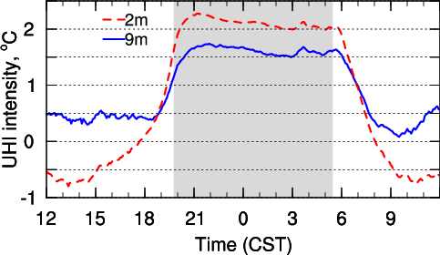
Diurnal variation of UHI intensity in OKC
Mean in July 2003
UHI intensity normally increases around sunset quickly and then stays at a roughly constant level throughout the night.
Notes:
Such UHI characteristics were reported for many cities.

Slide 52
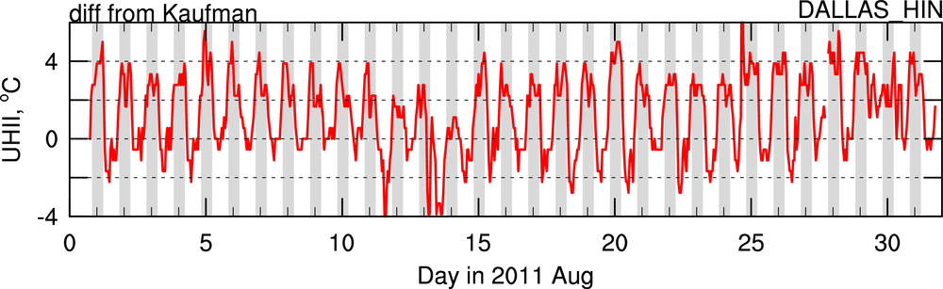
Unique variation of nocturnal UHI in Dallas
Sharp decrease (“collapse”) of the nocturnal UHI intensity

Slide 53
Objectives of this study
  Understand such a unique temporal variation of the nocturnal UHI intensity in Dallas
  Investigate WRF model capability to reproduce UHI

Slide 54
Model domains and configurations
WRF3.6.1
12->4->0.8km
NOAH+Urban canopy model
Boundary layer scheme: YSU
Simulation period: August 7-8 2011
UHI intensity = T at Dallas Hinton – T at Kaufman
to be consistent with Winguth (2013, JAMC)

Slide 55
Observed variation of UHI, T, wind speed
Collapses of UHI coincided with wind maximum and rural nocturnal warming events

Slide 56
Map of wind, T2, RH, K_{h} at 00 and 06 UTC
Early evening
Midnight
Early evening
Midnight
0100 UTC
0600 UTC (0000 LT)
Dallas
Indications of a sea breeze front:
Cooler and moister air behind the front with stronger momentum and vertical mixing

Slide 57
Inland penetration of the sea breeze front
Midnight
Early evening
Afternoon
The sea breeze front approached Dallas around midnight (0600 UTC)

Slide 58
Tendency: difference between current and next hours
Early evening
Midnight
Wind
The inland penetration of sea breeze front can be clearly illustrated in the tendency of WSP, T2, RH.
Temperature
Relative Humidity

Slide 59
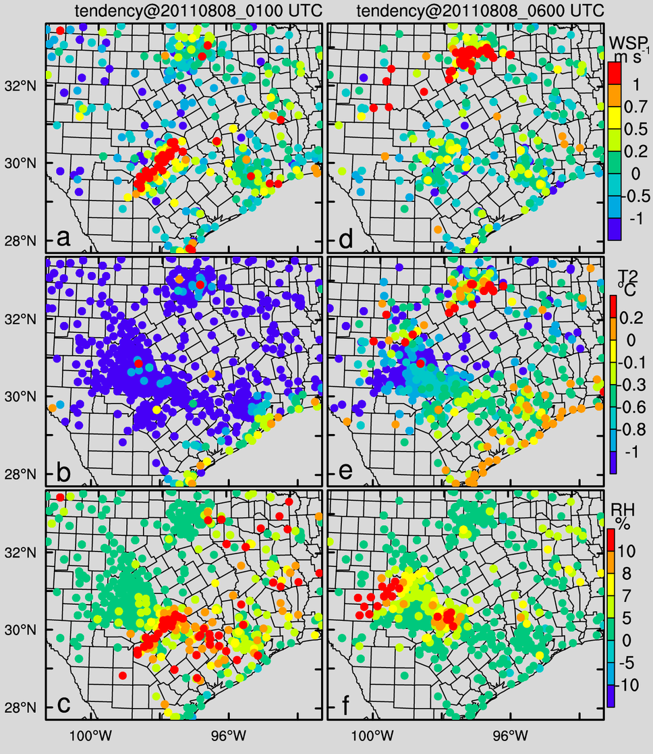
Observed tendency in MADIS data
Early evening
Midnight
MADIS integrated data from many providers
In the spatial distribution of tendency, the small scale local heterogeneity in instantaneous values is removed and only the spatial information of temporal variation is remaining.

Slide 60
Vertical cross-section of wind and its perturbation
wind
perturbation
Noon
Early evening
Sea breeze develops in the
morning and is advected
by Low-Level Jet at night
Midnight
Synoptic sea breeze
Dallas

Slide 61
Different response to the front in rural and urban
Rural:
Stable
Urban:
nearly neutral

Slide 62
Simulated variation of T, and UHI intensity
Nocturnal warming in rural and non-warming in urban lead to collapse of UHI

Slide 63
Observed variation of UHI intensity in Dallas

Slide 64
Conclusions
“collapse” of nocturnal UHI intensities occurred frequently around mid-night in August 2011 in Dallas.
2. Sea breeze circulation cells can be advected to Dallas and influence its UHI
3. Sea breeze frontal passage induced nocturnal warming events in rural area, while it did not alter urban boundary layer much.

Slide 65
References
Hu, X.-M.,F. Zhang, G. Yu, J.D. Fuentes, and L. Wu (2011), Contribution of mixed-phase boundary layer clouds to the termination of ozone depletion events in the Arctic. Geophys. Res. Lett., 38, L21801, doi:10.1029/2011GL049229.
Hu, X.-M., D. Doughty, K.J. Sanchez, E. Joseph, and J. D. Fuentes (2012), Ozone variability in the atmospheric boundary layer in Maryland and its implications for vertical transport model, Atmos. Environ.,46,354-364.
Hu, X.-M., P. Klein , M. Xue, F. Zhang, D. Doughty, R. Forkel, E. Joseph, and J. D. Fuentes (2013a), Impact of the Vertical Mixing Induced by Low-level Jets on Boundary Layer Ozone Concentration, Atmos. Environ., 70, 123-130.
Hu, X.-M., P. M. Klein, M. Xue, J. K. Lundquist, F. Zhang, and Y. Qi (2013b), Impact of low-level jets on the ncturnal urban heat island intensity in Oklahoma City. J. Appl. Meteor. Climatol., doi:10.1175/JAMC-D-12-0256.1.
Hu, X.-M., et al. (2014), Impact of the Loess Plateau on the Atmospheric Boundary Layer Structure and Air Quality in the North China Plain: A Case Study, Science of the Total Environment, 10.1016/j.scitotenv.2014.08.053
Hu, X.-M., and M. Xue (2016), Influence of synoptic sea breeze fronts on the urban heat island intensity in Dallas-Fort Worth, Texas, Mon. Wea. Rev., doi:10.1175/MWR-D-15-0201.1.
Hu, X.-M., M. Xue, and X. Li (2019), The Use of High-Resolution Sounding Data to Evaluate and Optimize NonLocal PBL Schemes for Simulating the Slightly Stable Upper Convective Boundary Layer. Mon. Wea. Rev., doi:10.1175/MWR-D-19-0085.1.
Hu, X.-M.,Li, X., Zhou, B., & Xue, M. (2024). Air Pollution Meteorology. Reference Module in Earth Systems and Environmental Sciences: Elsevier. doi:10.1016/B978-0-323-96026-7.00021-7 .

